Slide 1
Sustainable Packaging Session for the Meat Industry
Hosted by the Australian Institute of Packaging (AIP)
Sunday 23 July 2023

Slide 2
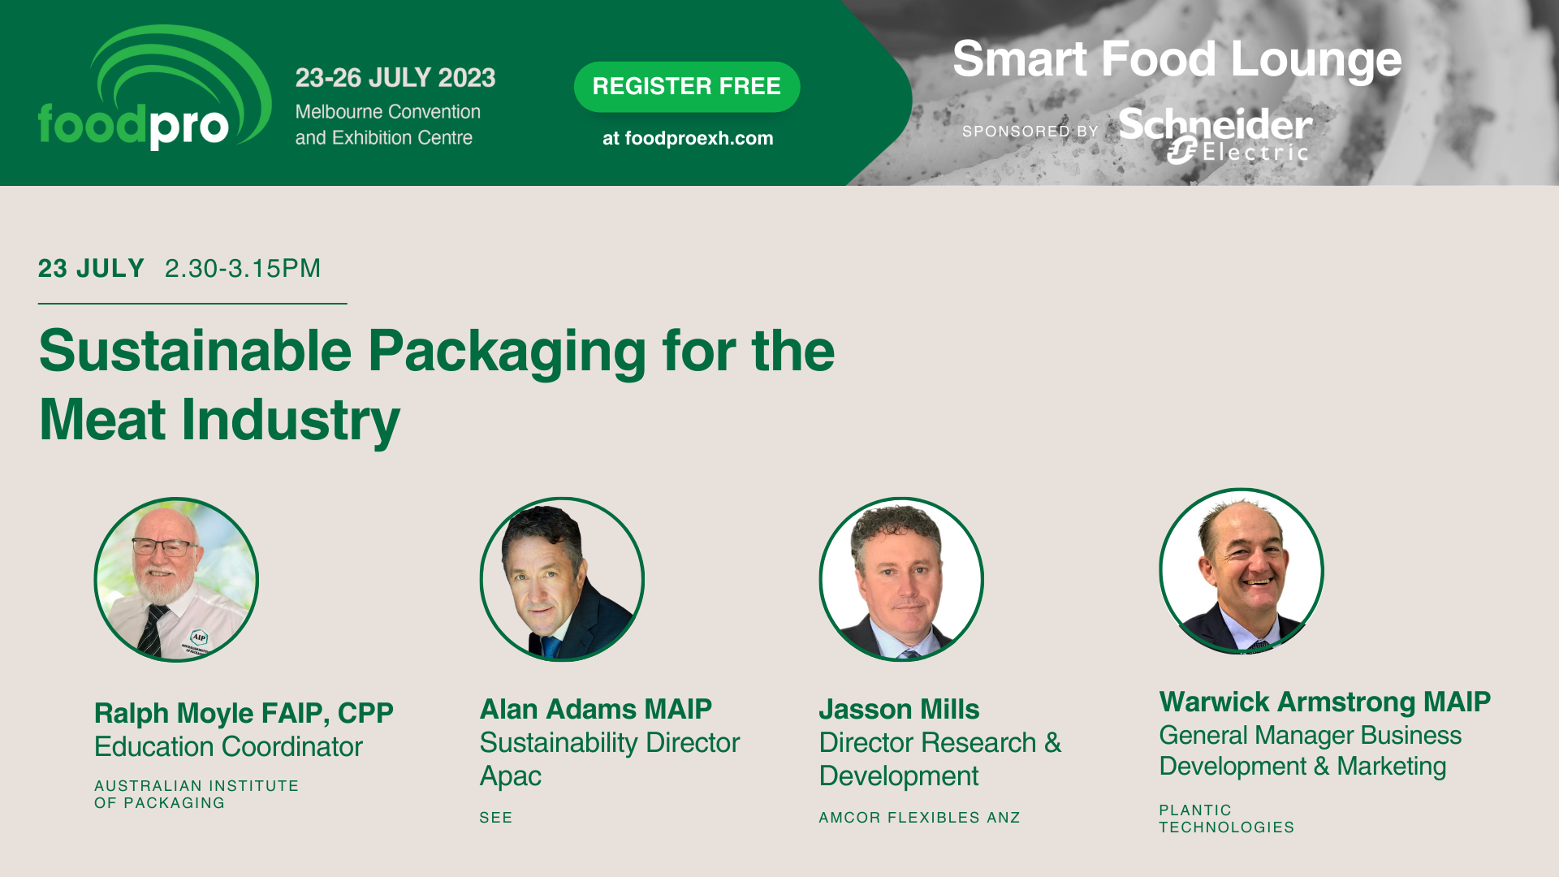
Speakers

Slide 3
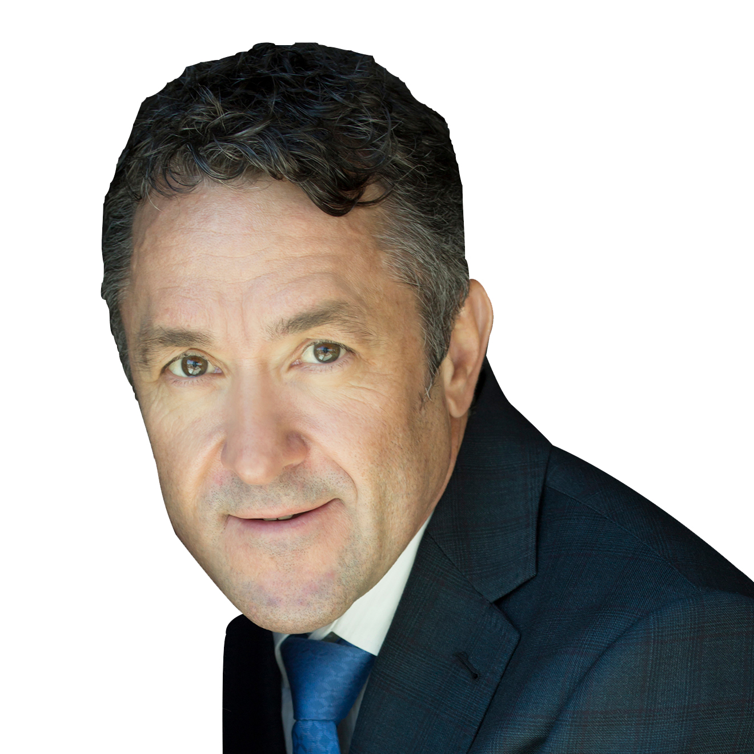
Speakers
Alan Adams MAIP
Sustainability Director APAC
SEE

Slide 5
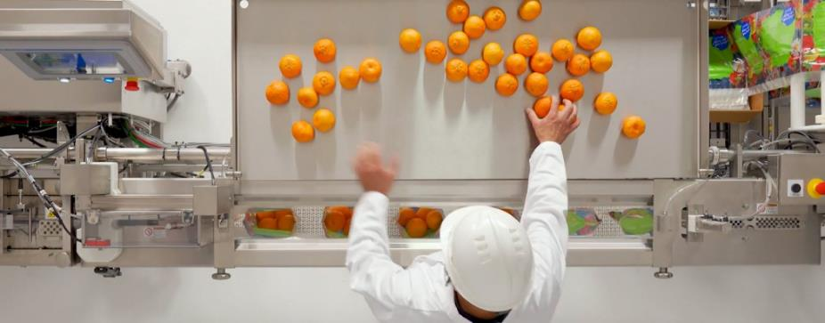
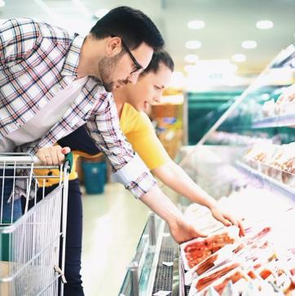
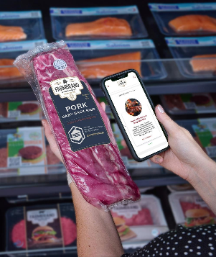
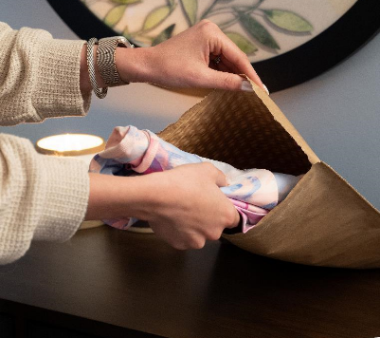
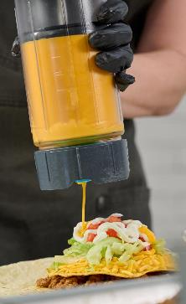
SEE is in business to protect, to solve critical packaging challenges, and to make our world better than we find it.
SEE supplies packaging for more than
30 BILLION products globally each year.
© 2023 | SEE | SUSTAINABLE MEAT PACKAGING
Notes:
At Whether, lead with Hello, I’m Alan Adams….
Trusted…why do I say trusted???

Slide 6
SEE is in business to protect, to solve critical packaging challenges, and to make our world better than we find it.
SEE supplies packaging for more than
30 BILLION products globally each year.
© 2023 | SEE | SUSTAINABLE MEAT PACKAGING
Notes:
At Whether, lead with Hello, I’m Alan Adams….
Trusted…why do I say trusted???

Slide 7
THE CURRENCY OF ACTION
Together, our actions pay dividends for your business and our planet
Innovative market-ready solutions
Design out costly waste
Reduced carbon footprint
Greater circularity
© 2023 | SEE | SUSTAINABLE MEAT PACKAGING

Slide 8
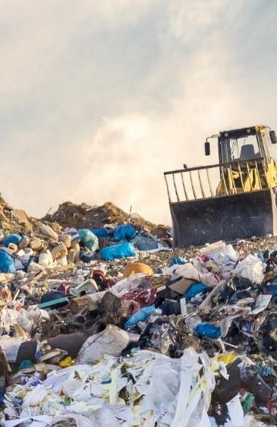
Sustainable packaging design is a balancing act
© 2023 | SEE | SUSTAINABLE MEAT PACKAGING
Notes:
..and when you get it wrong, the consequences can be catastrophic.

Slide 9
Under-packaged:
Increased food waste
Overpackaged:
Increase packaging waste
Optimised for sustainability
Think beyond recovery and adopt
a holistic approach
Packaging cost
Notes:
An easy way to get it wrong is to design mostly for end of life recovery…
Balancing the resources used and eliminating very costly food waste and food losses is a key defining measure of packaging design.
Not only is food waste and loss costly it’s also an environmental nightmare
This is part of the balance that is embedded in creating a low carbon circular future

Slide 10
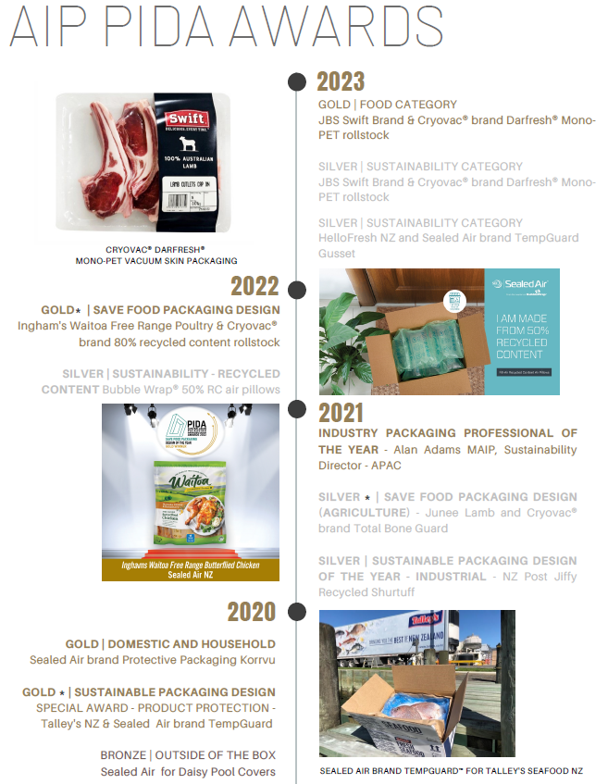
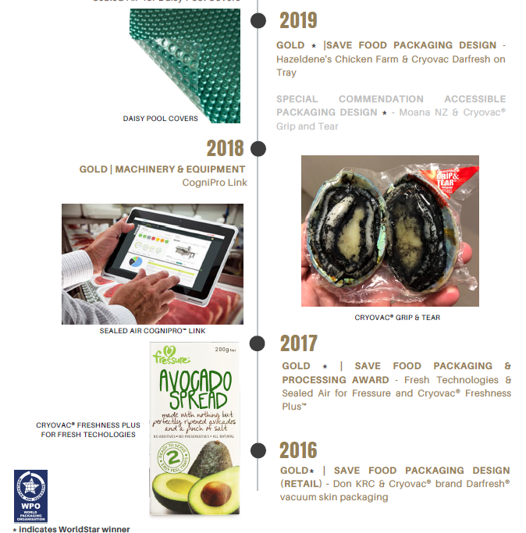
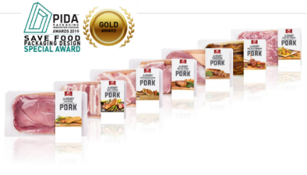
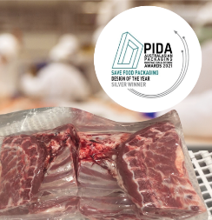
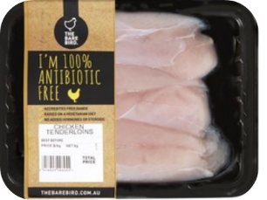
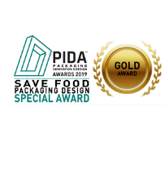
Supporting Australia’s fresh meat sector
for more than 78 years, backed by 16 PIDA and WorldStar industry awards
© 2023 | SEE | SUSTAINABLE MEAT PACKAGING
Notes:
And this is how SEE does it. Our cryovac brand has been supporting ….. Industry awards…
23 awards across PIDA and worldstar since 2016, with 3 president awards for save food.
These solutions are at the heart of our brand promise to protect and to deliver sustainable outcomes. Our CRYOVAC brand recipient of 3 WorldStar Save Food Awards – demonstrating packaging optimisation for Australia’s fresh protein sector.

Slide 11
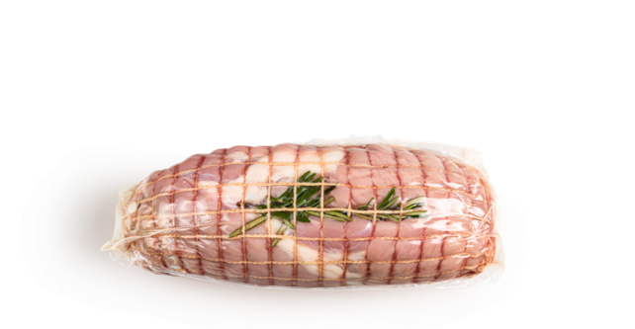
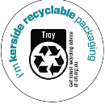
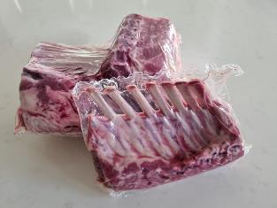
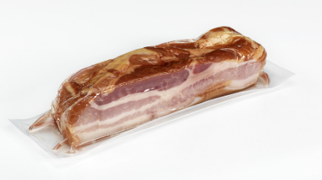
Today, > 90% of CRYOVAC® brand
food packaging for Australia’s protein
sector is recyclable or recycle-ready
CRYOVAC® brand R90 barrier vacuum shrink bag
CRYOVAC® brand thermoform top and bottom webs
CRYOVAC® brand rGuard barrier vacuum shrink bag
Mono RIC4 compatible
Contains >90% PE
Domestic retail (boneless applications)
Shelf life extension
Mono RIC4 compatible
Domestic retail (bone-in)
Shelf life extension
Mono RIC4 compatible
Shelf life extension

Slide 12
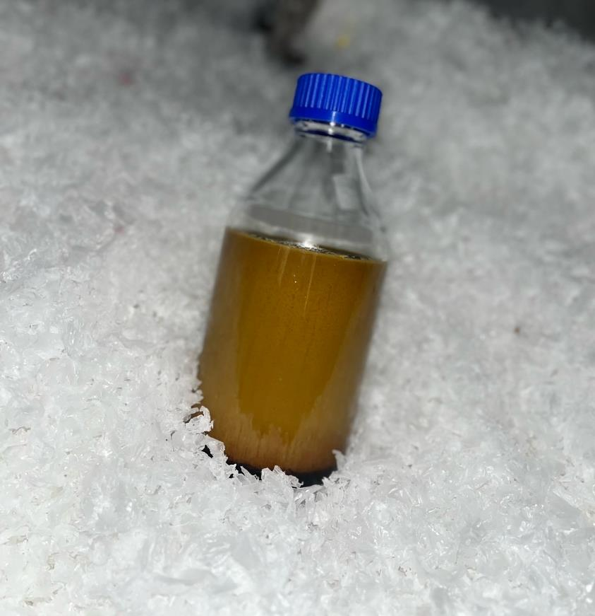
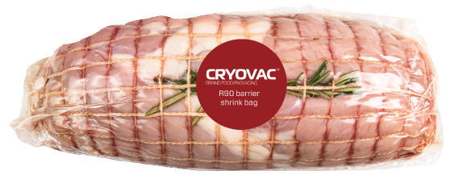
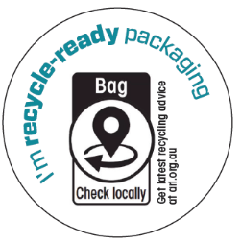
Investing in Circularity:
Advanced Recycling
From this….
…to this.
….to this.
SEE Australia collaborating with APR Plastics successfully ran new Cryovac® brand R90 barrier vacuum shrink bag through advanced recycling
© 2023 | SEE | SUSTAINABLE MEAT PACKAGING
Notes:
A circular economy for packaging with strict hygiene and performance requirements for food protection
Recycling essential packaging materials requires innovative solutions beyond traditional recycling

Slide 13
Don’t chase your tail.
Get smart!
Consumer recycling is the first step to circularity.
Smart packaging can educate and inform consumers where and how
to recycle your brand’s packaging, no matter their location.
© 2023 | SEE | SUSTAINABLE MEAT PACKAGING
Notes:
As we move to circularity, it can quickly come unstuck if consumers aren’t playing their part.. Consumer recycling is critical to circularity and when packaging is made smart, brands can enable greater recovery of their products packaging.

Slide 14
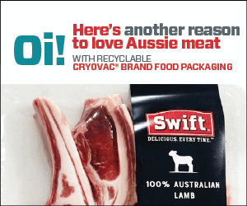
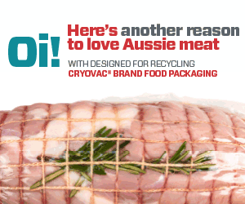
Wrapping up sustainable packaging
for Australia’s meat sector
SEE proudly supports Australia’s love of Aussie meat through sustainable packaging that protects products and our planet.
Global collaboration and circularity shapes the development of materials to meet packaging targets as regulated by APCO.
Advanced recycling is here!
Digital and automation drive sustainable outcomes.
Together, our actions pay dividends for your business and our planet.
Notes:
..and when you get it wrong, the consequences can be catastrophic.

Slide 15
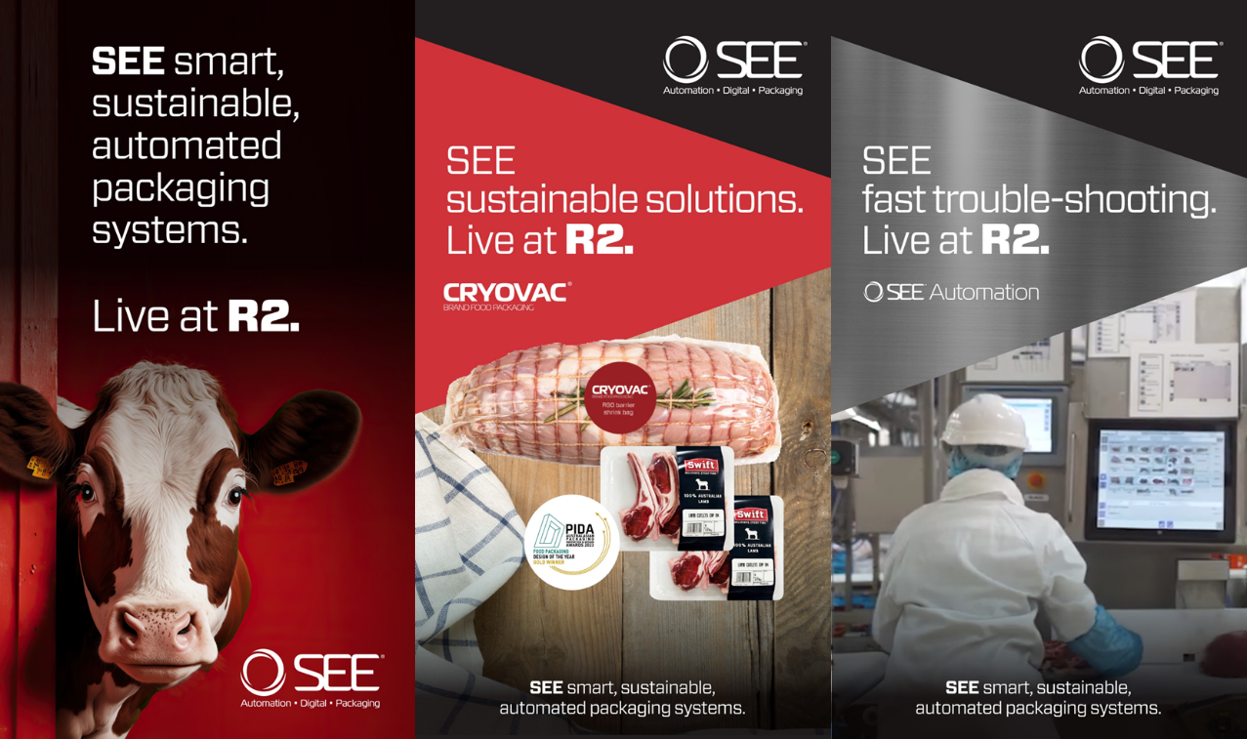
Thank you and we invite you to learn more at R2
© 2023 | SEE | SUSTAINABLE MEAT PACKAGING
Notes:
Remember to thank Diversified for foodpro event and AIP for invite to panel

Slide 16
Thank you.

Slide 17
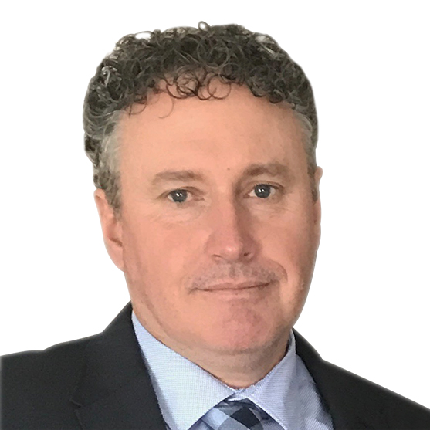
Speakers
Jasson Mills
Director Research &
Development
AMCOR FLEXIBLES ANZ

Slide 18
Ecotite R
®
Sustainable Barrier Shrink Bags for Protein

Slide 19
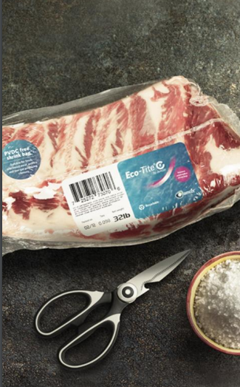
What is
The first ANZ manufactured PVDC free shrink bag for Protein.
Fresh Meat
Processed Meat
Cheese
Amcor’s new Ecotite® R bag is the first locally designed and manufactured recycled shrink bag to be launched in ANZ, which will meet the new APCO guidelines.
Ecotite® R provides a sustainable alternative to the current PVdC and PET barrier bags available in Australia, which can only be disposed of in landfill.

Slide 20
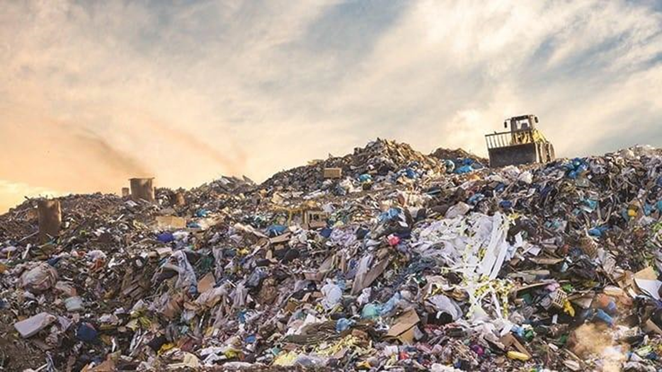
The need
Amcor’s pledge to the market is that we will have an offering for all packaging that is 100% recyclable, reusable or compostable by 2025.
PVdC has been the barrier component of choice for protein packaging for decades and one of the largest non-recyclable flexible packaging formats by volume due the PVdC content in the product.
The PVdC based product is used by both domestic and export customers. This needs to be removed to make the packaging compliant with proposed recycling rules and guidelines in Australia, New Zealand, the EU, UK, South Korea and other jurisdictions.
These rules and guidelines also limit or exclude the use of, PET and EVOH that have the ability to impact materials recycling.

Slide 21
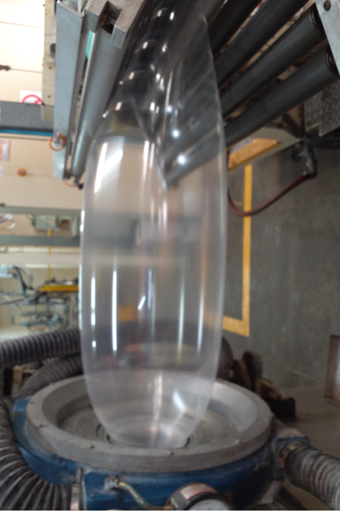
The Development
The brief was to develop a PVdC free shrink film that complied to the relevant rules and guidelines that also limited or excluded the use Nylon, PET and EVOH. These have the potential to impact the recyclability of the film..
As there was no current commercial solution within Amcor a team was formed utilising the expertise of both the local ANZ and Global R&D teams to develop a solution that could be made on the existing assets.
Initially, a material solution was developed and proven using a specialised blown film line in Amcor Europe, however this could not be run on the local ANZ assets.
The local engineering team then went away reviewed internally and through a mix of out of the box thinking along with some Kiwi ingenuity a pilot line was modified for proof of principle trials. This was than applied to commercial lines.

Slide 22
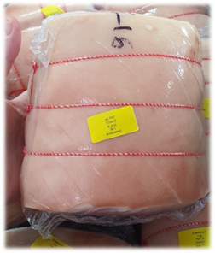
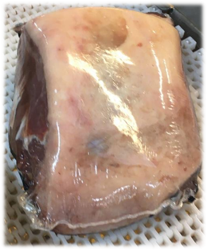
The Outcome
Phase 1 of the role out was targeted at protein packing for the ANZ domestic market which as been achieved and has also delivered additional benefits,
- The bags are 6% lighter at the same thickness than the current PVdC based bags
- Reduced the non-renewable primary energy demand by up to >60%.
- >45% lower Carbon footprint.
- >55% less water consumption over its manufacturing lifecycle.
The above is based on the Life Cycle Assessment which is certified by Amcor’s Carbon Trust certified ASSET.

Slide 23
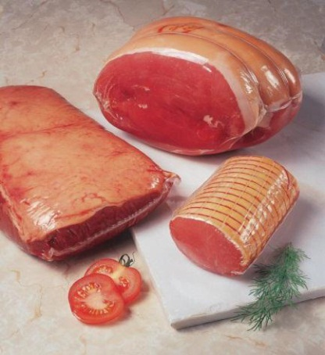
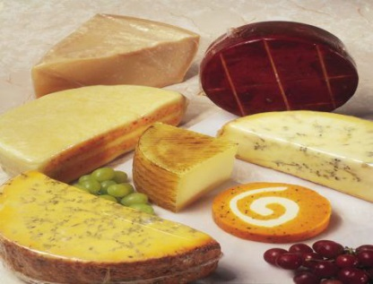
What's Next
Based on the success of the domestic product, development is underway to role out Ecotite® R for the export market including bulk cheese application.
In preparation of this, the Ecotite® R has been independently verified as recyclable by the cyclos - HTP Institute in Germany which ensure that Ecotite R bags are easily recycled in a polyolefin waste stream.
Work is underway to introduce PCR content into the film to ensure our customer base will be well placed to meet the impending need for flexibles to have recycled content.

Slide 24
Thank you.

Slide 25
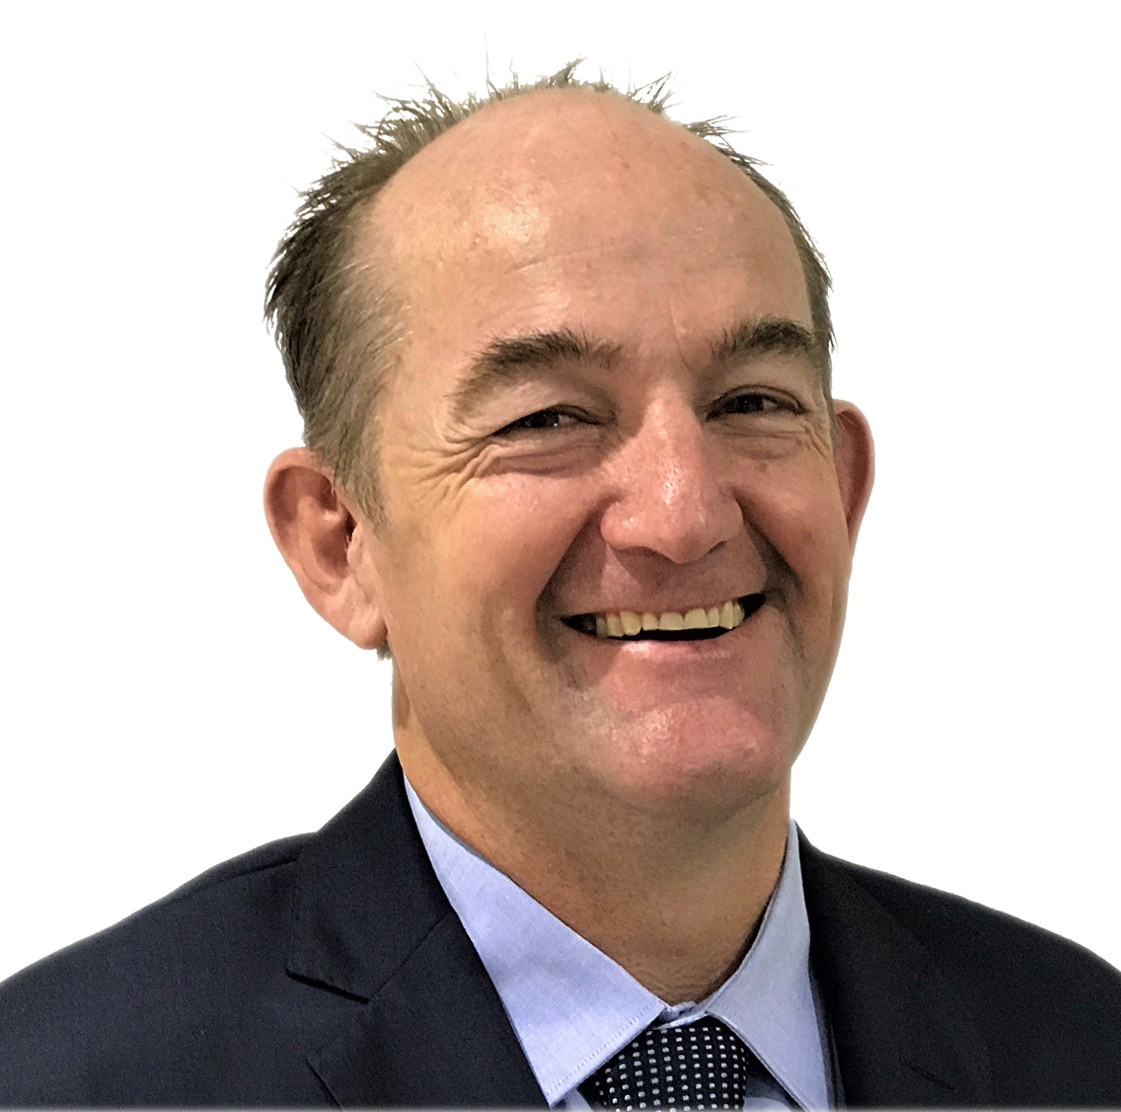
Speakers
Warwick Armstrong MAIP
General Manager Business
Development & Marketing
PLANTIC TECHNOLOGIES

Slide 26
Foodpro 2023
Kuraray / Plantic Technologies

Slide 27
Introduction
Kuraray Co. Ltd., founded 1926 in Kurashiki, Japan.
World’s largest producer of PVOH (POVAL™), EVOH (EVAL™) and many other specialty resins, chemicals, fibers and textiles.
Leader in barrier technology and development.

Slide 28
A snapshot of our business…
11,219
¥629,4B
¥20.6B
52
NUMBER OF EMPLOYEES
($5.7B) NET SALES
($181M)
R&D INVESTMENT ANNUALLY
WORLDWIDE PRODUCTION BASES

Slide 29
Plantic
PLANTIC™ is a high barrier biopolymer made from starch and is designed to meet the growing world demand for a sustainable approach to plastics technology.
Starch Is Found In Plants Including Maize, Potato, Rice, Wheat Tapioca
Privatised by Gordon Merchant in 2010 (Founder of Billabong and early investor in Plantic 2004)
Purchased by Kuraray in 2015
High Gas Barrier.

Slide 30
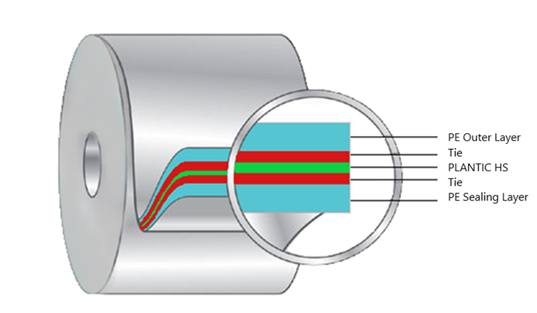
Plantic™
PLANTIC™ Mono layer can be coated with a range of materials including
Conventional solutions
PA, PE, PET, PP,
Compostable solutions
PBS, PLA, Bio PE, Cellulose, Paper
Recycled solutions
RPET

Slide 31
Developments
First in the world to introduce a renewable plant based barrier material 2004
First in the world to introduce a high barrier recyclable material 2011
First in the world to introduce high barrier structures made from recycled and renewable materials 2018
Use of Plantic materials have saved 65 million kilos of greenhouse gases and counting
Global award winning packaging formats

Slide 32
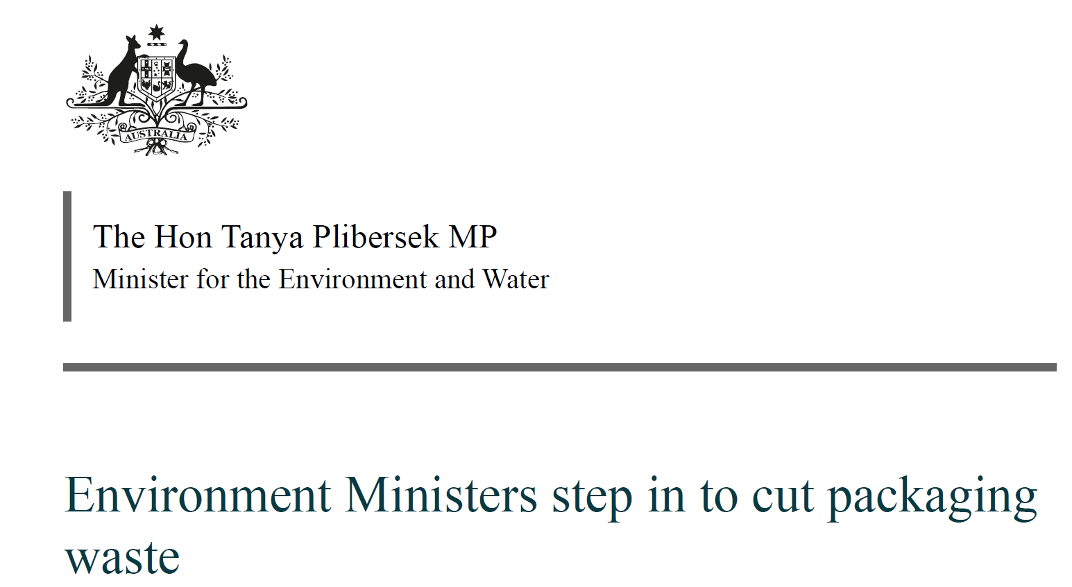
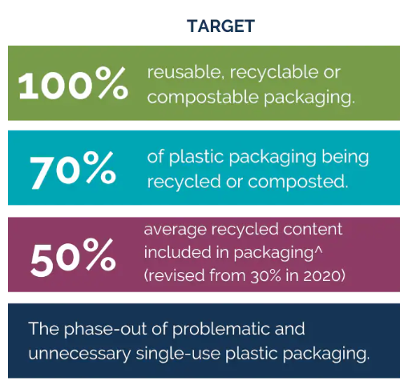
Australian Targets
9th June 2023
Mandatory designs for recycled content
Voluntary targets and designs aren’t working
Three million tonnes of packaging sent to landfill
𝛍m

Slide 33
Partnering with Kuraray Paper & Packaging

Slide 34
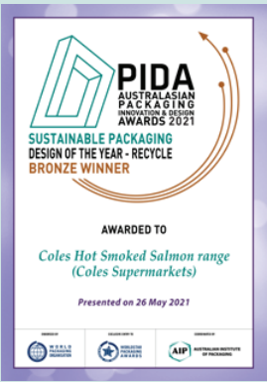
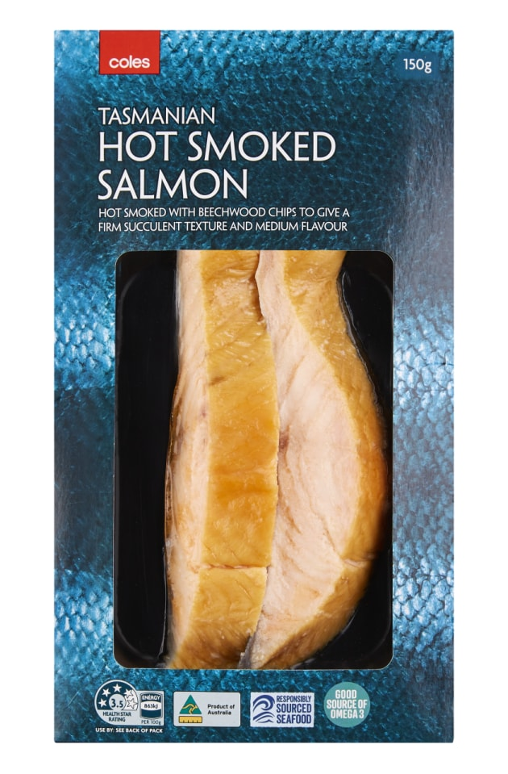
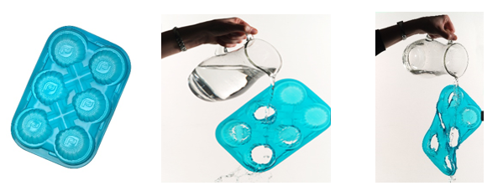
Award Winning Designs
Recycling Colours
Black tray has no carbon
Plantic core is coloured
Patent technology makes the finished pack recyclable
Recycled and renewable content

Slide 35
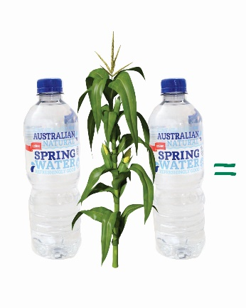
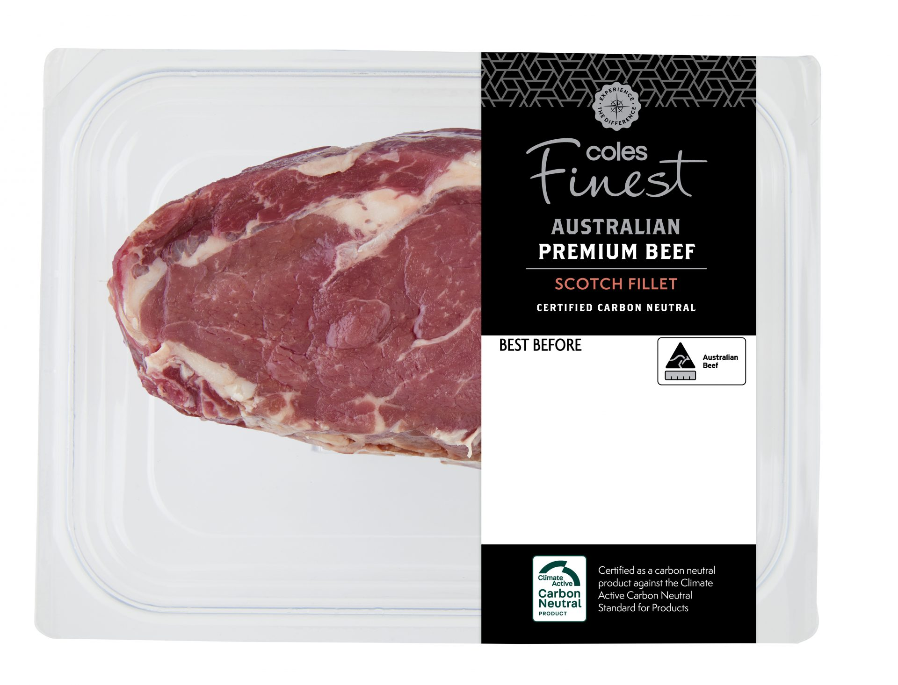
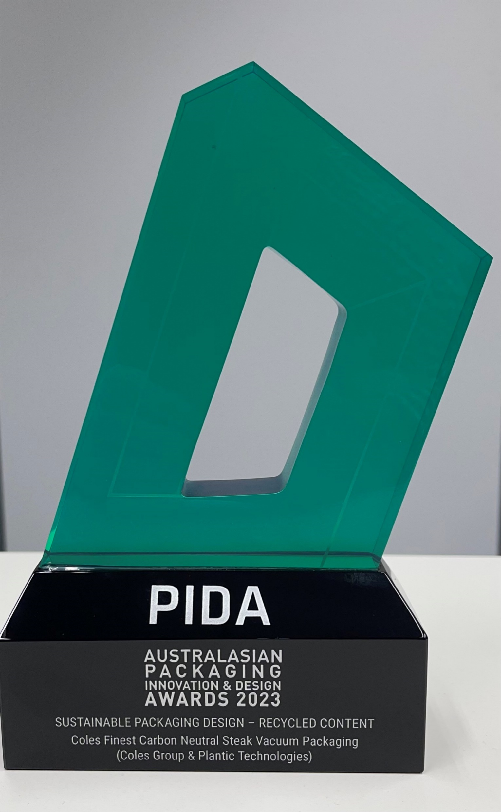
Award Winning Designs
Combination believed to be a World first Carbon neutral product and pack
Plantic is a ultra high barrier plant based polymer.
Combined with recycle content.
Patent technology makes the finished pack recyclable.
Carbon neutral beef.
Extended shelf life.

Slide 36
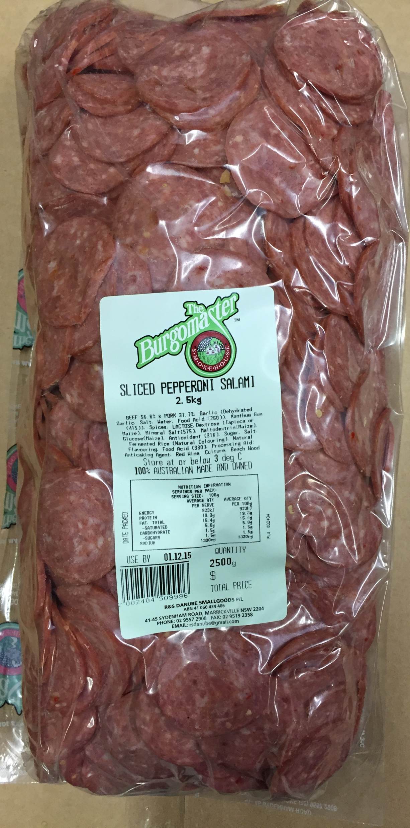
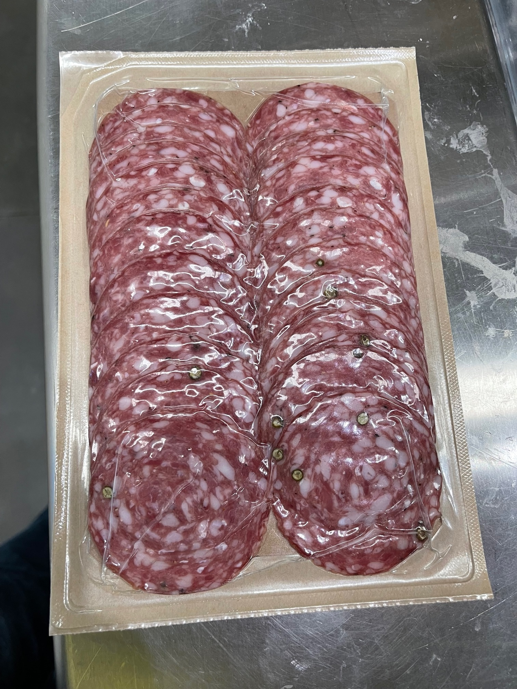
Award Winning Designs
New core resin layer
High Barrier
Deep draw
Combined with paper lidding or base
High impact resistance

Slide 37
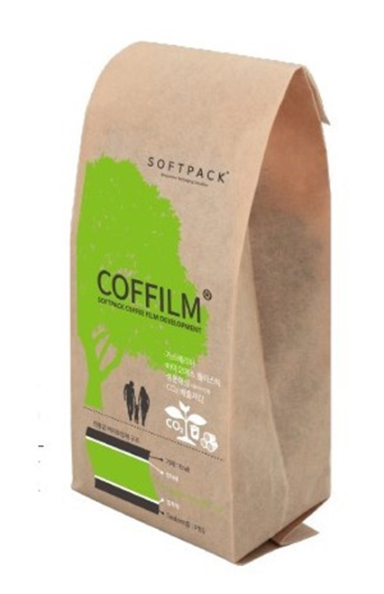
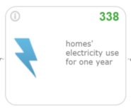
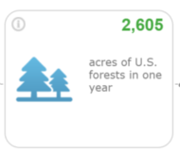
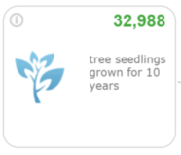
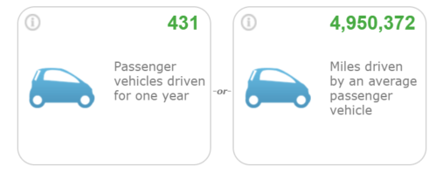
Award Winning Designs
Life Cycle Assessment comparing a barrier pouch film against both brown and bleached Kraft Plantic PF pouch films.
Both Plantic PF showed 3 times lower Greenhouse Gases (GHG) level (199.5% Higher Kg- CO₂ compared to equivalent oil based plastic barrier pouch
Combining Plantic with other materials
High barrier paper
Compostable solutions

Slide 38
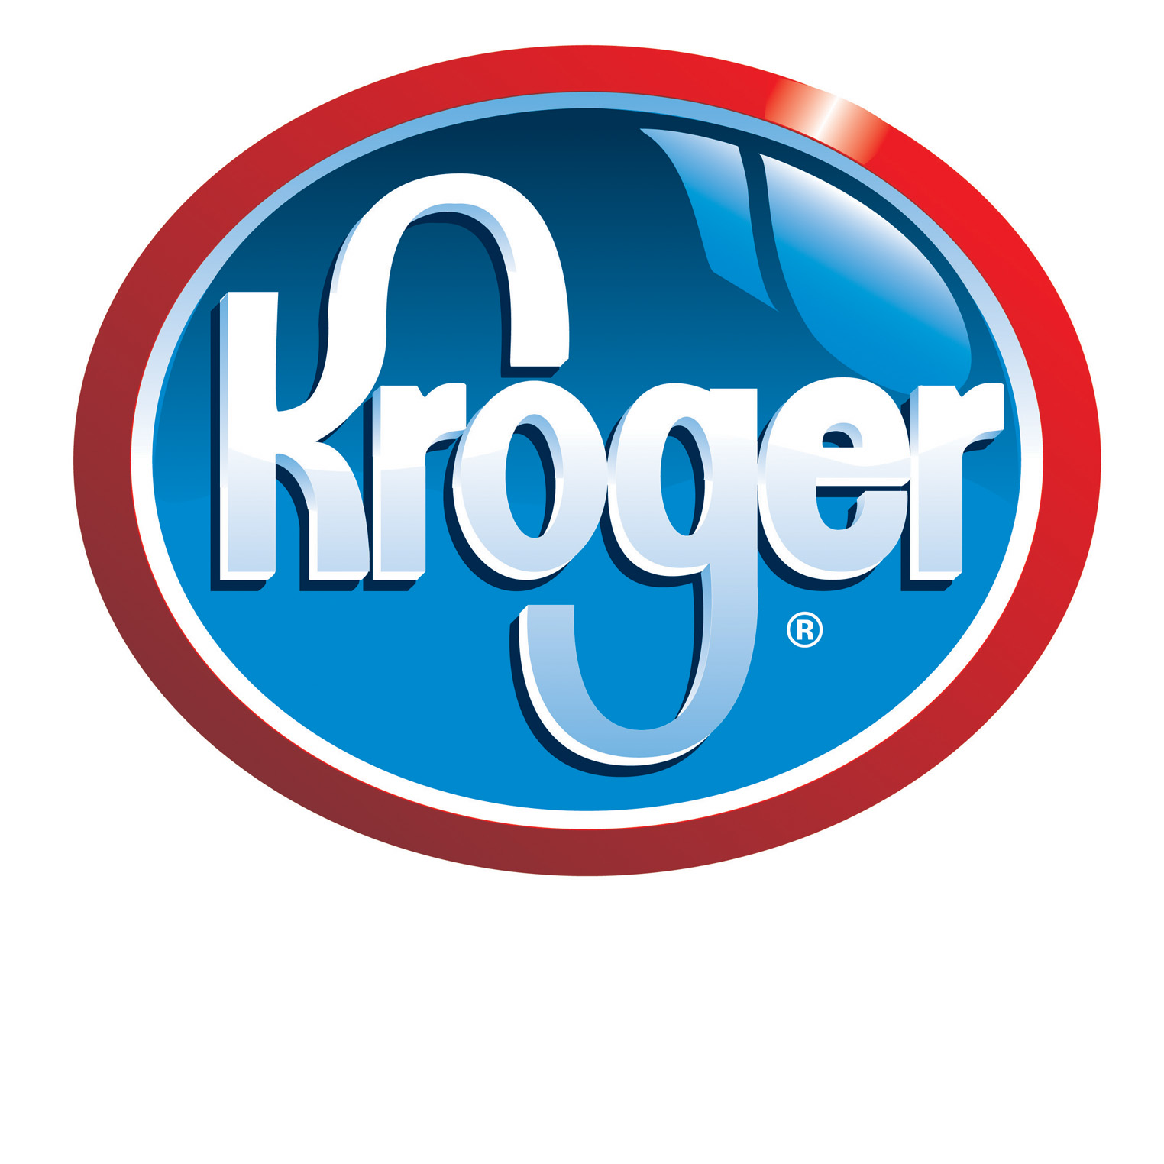
Supplying market leaders
𝛍m

Slide 39
Thank you.
Please visit the AIP stand K49 to find out how we can help you with all of your packaging training & education.

