Slide 1




Everything You Need to Know About Precision Fermentation
Joe Liu (Ph.D)
CSIRO, Agriculture & Food

Slide 2



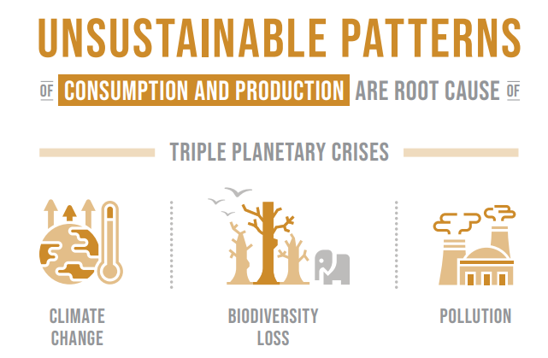




The Big Drivers
~ 10 b
+70%
Population
by 2050
More Food Needed
By 2050
Unsustainable Ag&Food systems
Other Increasing Consumer Demands
Food Security

Slide 3
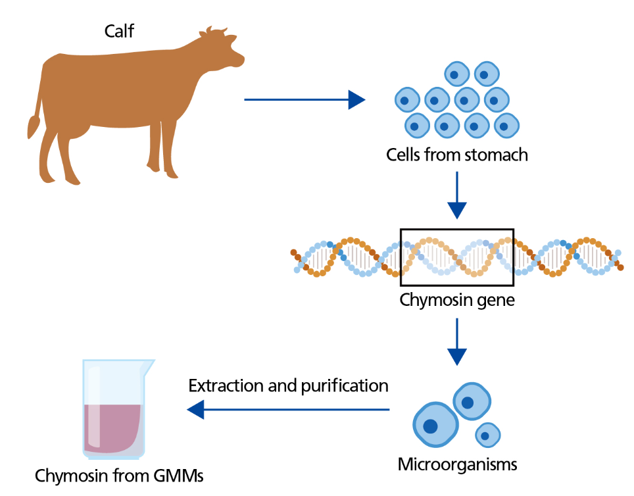


Precision Fermentation
Precision Fermentation
A form of specialized bioprocessing that uses microbes (usually GMO) as “cell factories” for producing specific functional ingredients, capable of producing proteins, vitamins, enzymes, natural food colour, and fats etc.

Slide 4
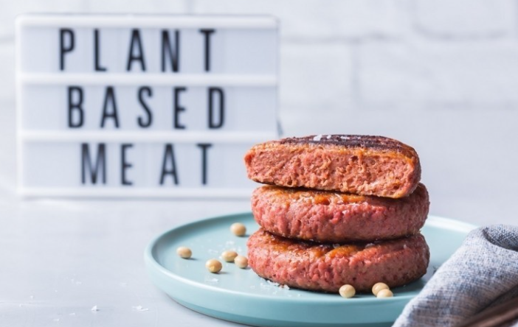
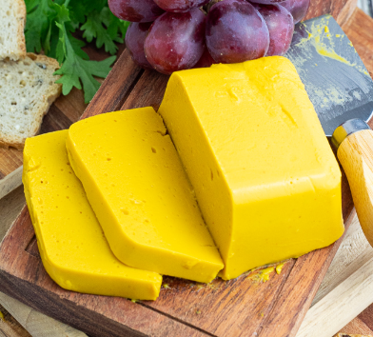
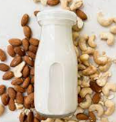

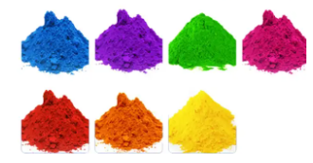


How does PF fit with other
novel food production systems
Plant-Based
Algae-Based
Insect-Based
Microbial Biomass Fermentation
Cell-Based (Cultivated Meat)
Lipid
Heme
Food Colour
B12
Precision Fermentation

Slide 5


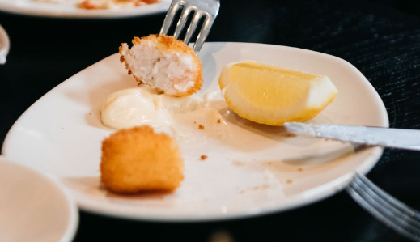
Commercial Case Studies – Nourish Ingredients
Precision fermentation technology to produce animal fats without using animal products or palm/coconut oil
Animal-free fermented fat as flavour and functional ingredients supplied to other next-gen foods such as plant-based, alternative non-dairy milk
“Cell-cultured meat meets animal-free fermented fat” – collaboration between cultured meat company Vow and Nourish Ingredients

Slide 6



Commercial Case Studies – Eden Brew
Synbio technology in yeast to produce milk proteins through precision fermentation
Precision fermentation processes commercial-scale development
Collaboration with local dairy giant Norco. Co-operative Limited to launch animal-free dairy products

Slide 7
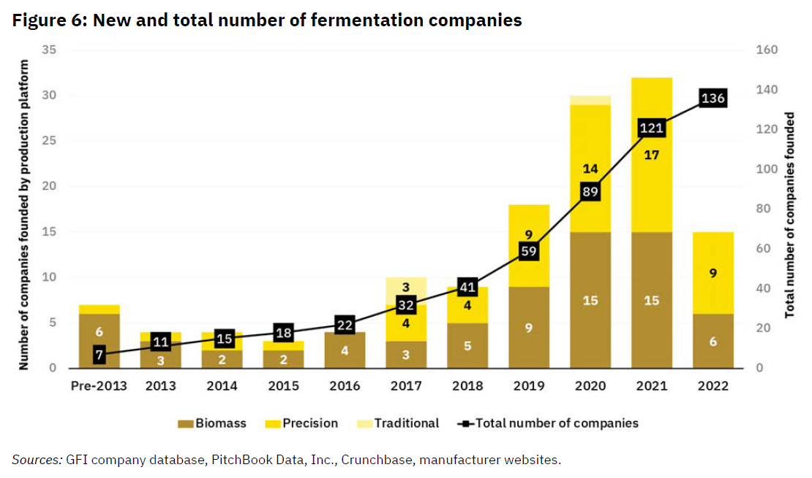
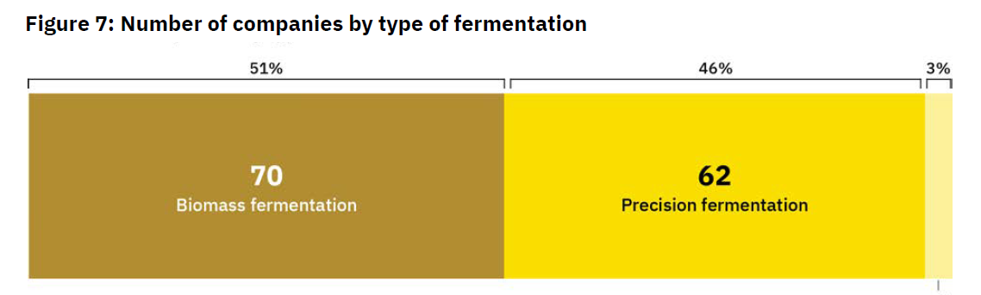
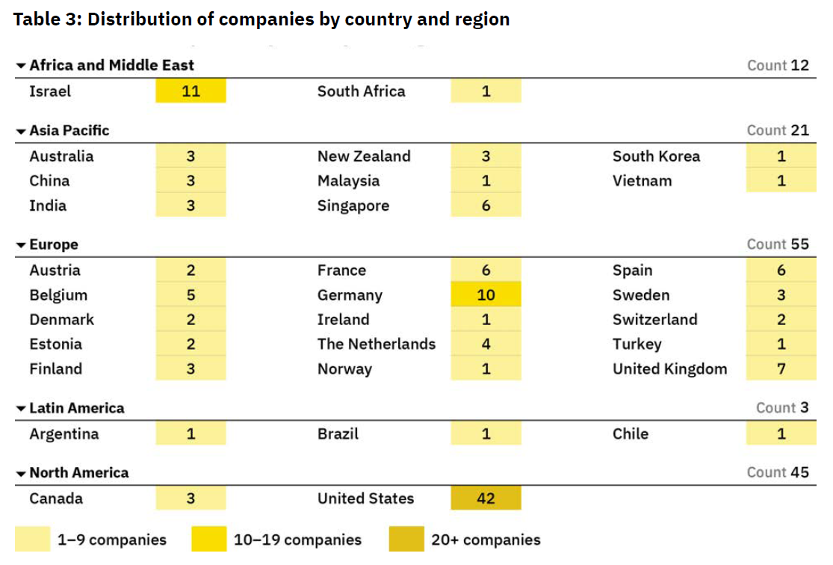
Commercial Landscape
Global

Slide 8
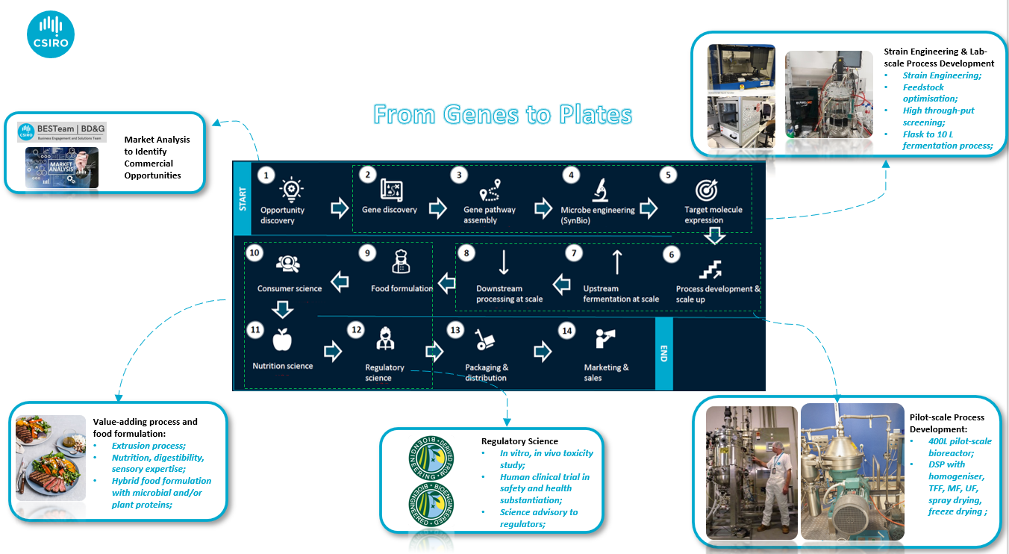
The Process Value Chain of Precision Fermentation
Strain Engineering
Lab-scale Process Development (Flask to ~20L with Lab DSP)
Pilot-scale Process Development (100L to 2,000L with Polit DSP)
Demo- and Commercial- scale Process Development (10,000L to 500,000L + with DSP)
Food Formulation and Processing, Nutrition, Digestion, Sensory etc.
Regulatory Science
Societal Science (TEA, LCA, Consumers etc.)
TEA
LCA
Societal

Slide 9
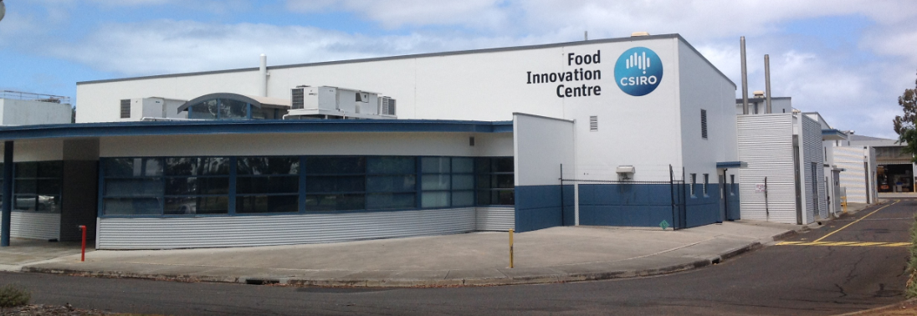
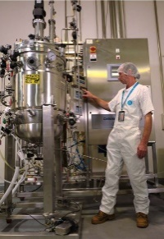
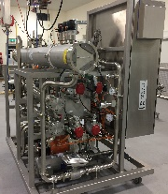
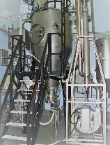
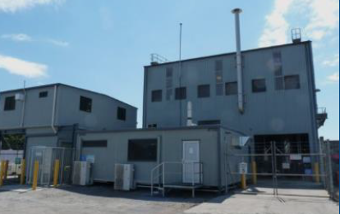
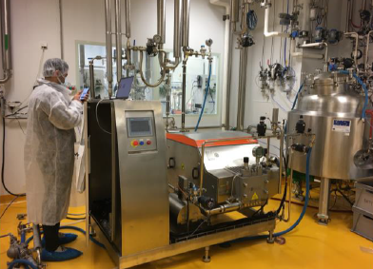
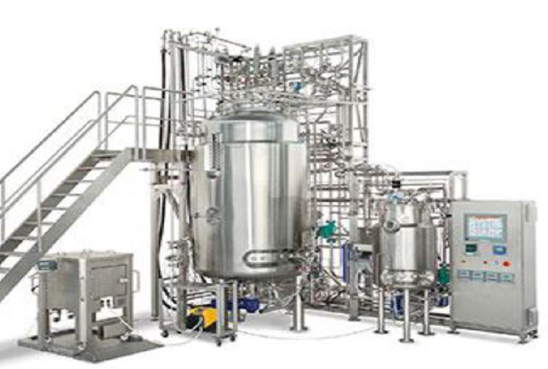

Challenges & Solutions
Strain Engineering
Lab-scale Process Development (Flask to ~20L with Lab DSP)
Pilot-scale Process Development (100L to 2,000L with Polit DSP)
Demo- and Commercial- scale Process Development (10,000L to 500,000L + with DSP)
Food Formulation and Processing, Nutrition, Digestion, Sensory etc.
Regulatory Science
Societal Science (TEA, LCA, Consumers etc.)
CSIRO Food Innovation Centre(Werribee) – Precision Fermentation Pilot Plant,400 Liter fermentation with DSP, Food Grade Facility
Queensland University of Technology (QUT), Mackay Renewable Biocommodities Pilot Plant – Precision Fermentation, 2,000 L fermentation with DSP, Food Grade Facility
Cauldron Ferm (NSW) – CDMO for precision fermentation, 10,000 L to 100,000’s Liters fermentation with DSP.

Slide 10





Challenges & Solutions
Strain Engineering
Lab-scale Process Development (Flask to ~20L with Lab DSP)
Pilot-scale Process Development (100L to 2,000L with Polit DSP)
Demo- and Commercial- scale Process Development (10,000L to 500,000L + with DSP)
Food Formulation and Processing, Nutrition, Digestion, Sensory etc.
Regulatory Science
Societal Science (TEA, LCA, Consumers etc.)
CSIRO A&F Engagement with FSANZ and relevant regulators
Ag & F waste as fermentation feedstock, Techno-economic analysis, Consumer acceptance – GMO technology, Price Parity, Market access etc.
Advanced Engineering Biology FSP
Future Protein Mission
Science
Impact
Innovative Bioproduction Platforms
Data-driven Molecular Design
Interdisciplinary Decision-making
Plant-based protein
Sustainable animal protein
Novel protein production system

Slide 11
What next…
Relationship to other novel food production systems
Infrastructure (R&D, Commercial)
Government & Funding
Science & Technology
Food Companies
Markets / Consumer Demands
Whole Value Chain - from genes to plates
Scale-up infrastructure in Australia
Putting the pieces together…

Slide 12

Questions
Thank you & Questions

