Slide 1
Good for Business, People and the Planet
Commercialising excess food
Katherine Gokavi-Whaley | Chief Commercial Officer
@katherinegokavi-whaley
Notes:
The size of food waste in Australia is astronomical.
7.2 million tonnes every year.
This is going to take innovation and new solutions in every corner of our food systems.
I'm here to talk to you about one corner, one solution.
It's the 42% of Australia's annual food waste. The food that gets wasted before it even reaches supermarket shelves, let alone people's homes.
Before I tell you about the solution, let me tell you a story.

Slide 2
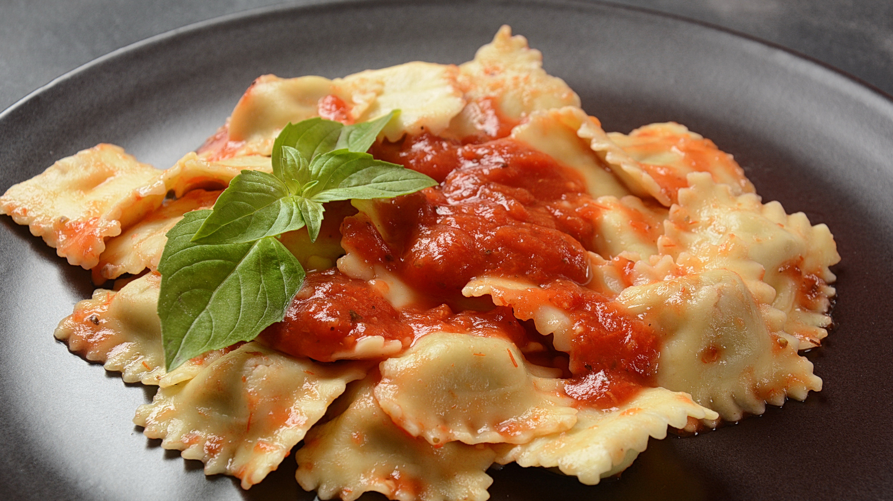
Notes:
Let me tell you a story about some excess ravioli.
10 tonnes were in excess due to a forecasting error.
The manufacturer had x2 clearance buyers to call up on their list.
After back and forth on the phone with the 2 buyers, trying to agree on a price and taking time out of core sales functions, 1 buyer took some of the stock.
But only 40% of it.
Back on the phone to customer service to now organise donation of the stock. Time is ticking on the shelf life.
The manufacturer has x1 FRO partner. And they can only accept a partial amount of the stock.
What happens to the rest?

Slide 3
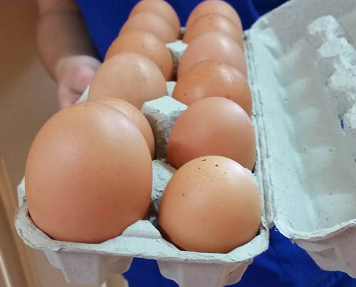
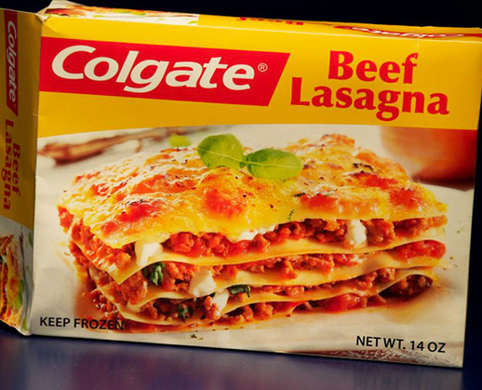
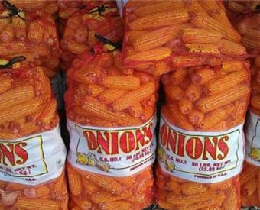
Excess is a reality of food manufacturing
SLOB
Off spec
NPD
Mislabelled
yumefood.com.au @katherinegokavi-whaley
Notes:
Whether it's SLOB, clearance, NPD, de-ranged, out of spec or mislabelled products - being left with
excess inventory is a reality of food manufacturing.
What doesn't have to be a reality is seeing it go to waste.

Slide 4
Understand the problem
"What happens to your excess inventory"
Notes:
And this is what we set out to do at Yume.
Before you set out to fix a problem - you have to understand the processes happening behind it.
Working alongside Mars, Unilever, General Mills, Kelloggs, we deep dived into the processes around excess inventory.
"What happens to your excess inventory"

Slide 5
Understand the problem
"What happens to your excess inventory"
"How efficient are your processes?"
Notes:
"How efficient are your processes?"

Slide 6
Understand the problem
"What happens to your excess inventory"
"How efficient are your processes?"
"Do you enjoy dealing with excess?"
Notes:
"Do you enjoy dealing with excess?"

Slide 7
Excess food is a silent killer
Notes:
We found it was the same for everyone. Excess food is a silent killer

Slide 8
Time
Efficiency
Resources
Excess food is a silent killer
Profit
Planet
Morale
Notes:
It's a silent killer of:
Time
Resources
Efficiency
Planet
Morale
Profit

Slide 9
Stuck with common problems
Inefficient sale and donation processes
Limited buyers
Donated too late
Written off or wasted
No data
yumefood.com.au
Notes:
Most companies had a system in place, but they all had common problems.
-sale & donation of excess stock is non-core business process that's inefficient and with a high administrative burden
-limited number of buyers (buyers market)
-Products are offered to FRO late
-unsold stock written-off and disposed of
-reporting is manual and fragmented and as result, there are no consolidated metrics.

Slide 10
A better way - tested by industry
A plug and play tech platform that commercialises and donates surplus food at scale
INPUTS
FINISHED PRODUCTS
FARM
MANUFACTURER
RETAIL
EXCESS
SELL
RAW MATERIALS
BY PRODUCTS
IMPERFECT
DONATE
yumefood.com.au
Notes:
We built a platform that addresses these common problems, with industry, for industry.
Buyers and sustainable procurement
Donation options

Slide 11
128%
more volume sold
by connecting to a diverse buyer network
Remember the ravioli?
149%
increase in price
through Yume's bidding system
30%
more products donated
with Yume waterfall technology
yumefood.com.au
Notes:
Remember the ravioli? Had that manufacturer had Yume at their fingertips they would have:
-Diverse buyers
-128% more volume was sold -149% increase in price
-30% more products donated
Automatically offered to FRO
And if the first FRO couldn't accept the entire consignment, it waterfalls down to another food rescue organisation, who can ensure food gets to people in need.

Slide 12
And that's just the beginning
+301,000 kgs
of excess stock sold in 12 months of using Yume
$782k
returned back in 12 months of using Yume
98%
of clearance stock sold using Yume technology
30%
CASE STUDY
increase in pricing when compared to results of in-house solution
$6 ROI
for every dollar spent on Yume tech
Notes:
+301,000 kgs of excess stock with Yume in 12 months
-Clearance rate to 98%
-$782k back in their pockets -30% increase in pricing
-40% less time on donation
-ROI of $6 for

Slide 13
5.6M
FOOD
kilograms of food redistributed, that much food could fill 30 Boeing 747s
1.3B
WATER
Operationalising sustainability
litres of embedded water in the food redistributed, that's the same amount of water in 520 Olympic pools
22.8M
$17 MILLION RETURNED BACK TO BUSINESSES
CO2
kilograms of Co2-equivalent embedded in the food redistributed, or the same amount of Co2 as 4,957 cars off the road for a year
882,734
MEALS
equivalent meals distributed to those in need, that's like giving everyone on the Gold Coast a meal
yumefood.com.au
Notes:
-$17 million back to businesses
-5.6 million kilograms (30 boeing 747s)
-882,000 meals donated (a meal for everyone on the gold coast)
-1.3 billion litres water (520 olympic pools)
-22 million Co2 (4,957 cars off the road for a year)

Slide 14
Our users are food industry leaders
Subscription Suppliers
1000+ Buyers, including;
Trial Subscription Suppliers
Charities

Slide 15
THE FUTURE IS IN OUR HANDS
Thank you
Katherine Gokavi-Whaley | Chief Commercial Officer
@katherinegokavi-whaley
yumefood.com.au

