Slide 1
Working to design and recover sustainable packaging
Using the ARL & SPGs
24 July 2023

Slide 2
8
‘‘
The Australian Packaging Covenant Organisation acknowledges the traditional custodians of the land on which we live and work. We pay our respects to their Elders, both past and present, and extend that respect to all Aboriginal and Torres Strait Islander peoples who contribute to the diversity and richness of this nation.
2
Notes:
Acknowledgement
Who is in the room?

Slide 3
Why do we exist?
The Australian Packaging Covenant Organisation (APCO) is a co-regulatory not-for-profit which partners with government and industry to reduce the harmful impact of packaging on the Australian environment. See back pocket slides for regulatory context.​
​
Our vision:​
A packaging value chain that collaborates to keep packaging materials out of landfill and retains the maximum value of the materials, energy and labour within the local economy.​
ALL AUSTRALIAN GOVERNMENTS
INDUSTRY
2000+ Members
3
Notes:
Key APCO Facts:
APCO currently has 2,500 members including brands big and small across Australia, New Zealand and Pacific
While the Covenant in Australia has been around since 1999, it has taken many different forms. From 2018, APCO adopted the principles of a circular economy and launched the 2025 National Packaging Targets
Since then, the team has grown to over 40 staff working across ANZ
Call out that APCO is not an industry association from 2018, our governance model started to reflect the intention to support environmental outcomes and now has independent, skills based, industry and member brand owner directors

Slide 4
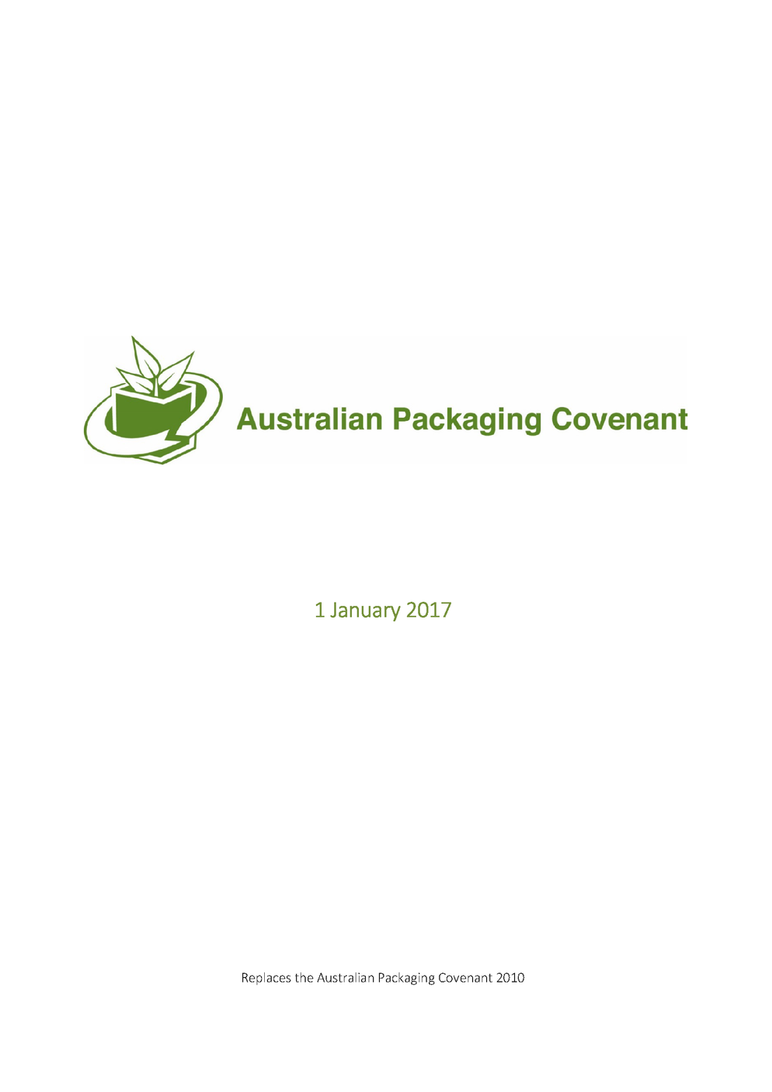
Regulation
The Australian government has implemented a range of policies and regulations to promote sustainable packaging practices.
APCO - provides a voluntary framework for businesses to improve the sustainability of their packaging practices
The Product Stewardship Act 2011 - which provides a framework for the management of products throughout their lifecycle, including packaging.
The National Environment Protection (Used Packaging Materials) Measure 2011 - which sets recycling targets for packaging waste and requires businesses to report on their packaging waste and recycling efforts.
4
Notes:
But really, we exist because of policies and regulation that have been put into effect to reduce packaging waste and improve circularity.
Two major programs:
Primary responsibility is to help organisations acquit their obligations under the NEPM by providing a streamlined reporting process to governments and providing the resources to help them improve their packaging.
Australasian Recycling Label is a voluntary program that helps organisations both improve their design and be able to communicate to consumers the correct disposal pathway for the packaging.

Slide 5
SPGs
Sustainable Packaging Guidelines

Slide 6
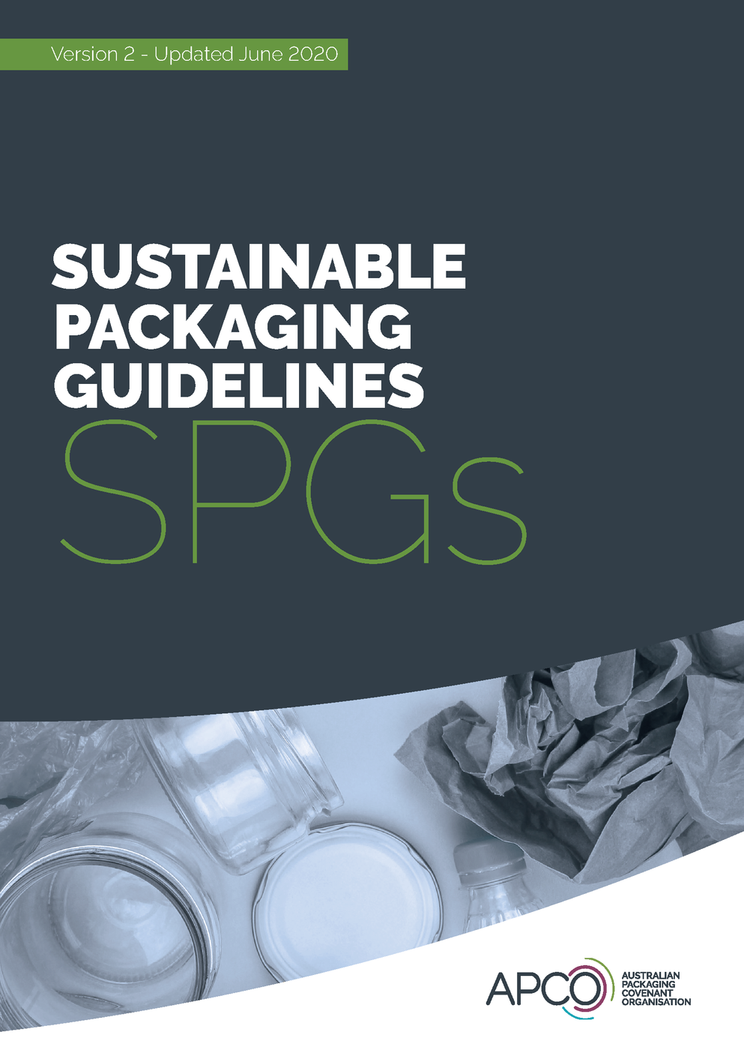
Sustainable Packaging Guidelines
Central part of the co-regulatory framework established by the NEPM
10 Principles to assist APCO Members in achieving the optimal outcomes to collectively work to meet the 2025 Targets
Detailed ‘Implementation Guide’ to help Members gain maximum value from the SPGs
6

Slide 7
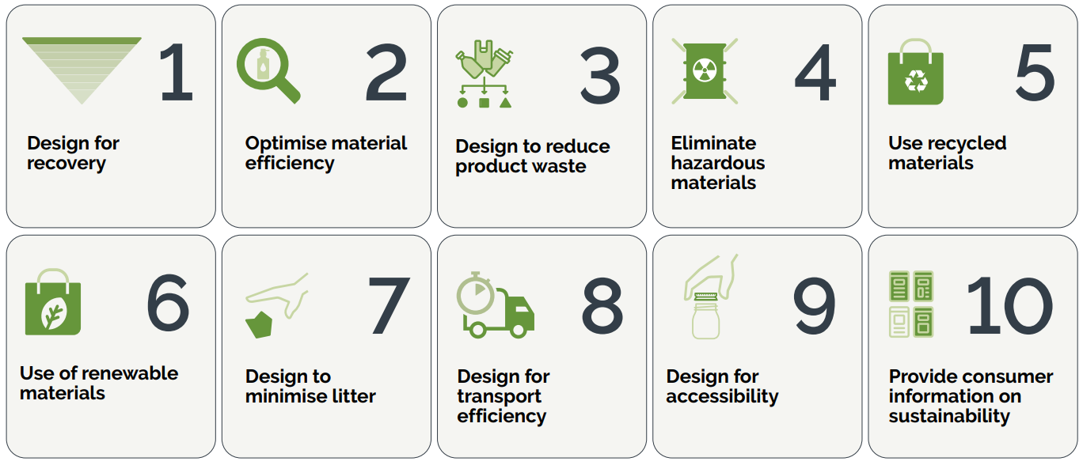
Sustainable Packaging Guidelines
7

Slide 8
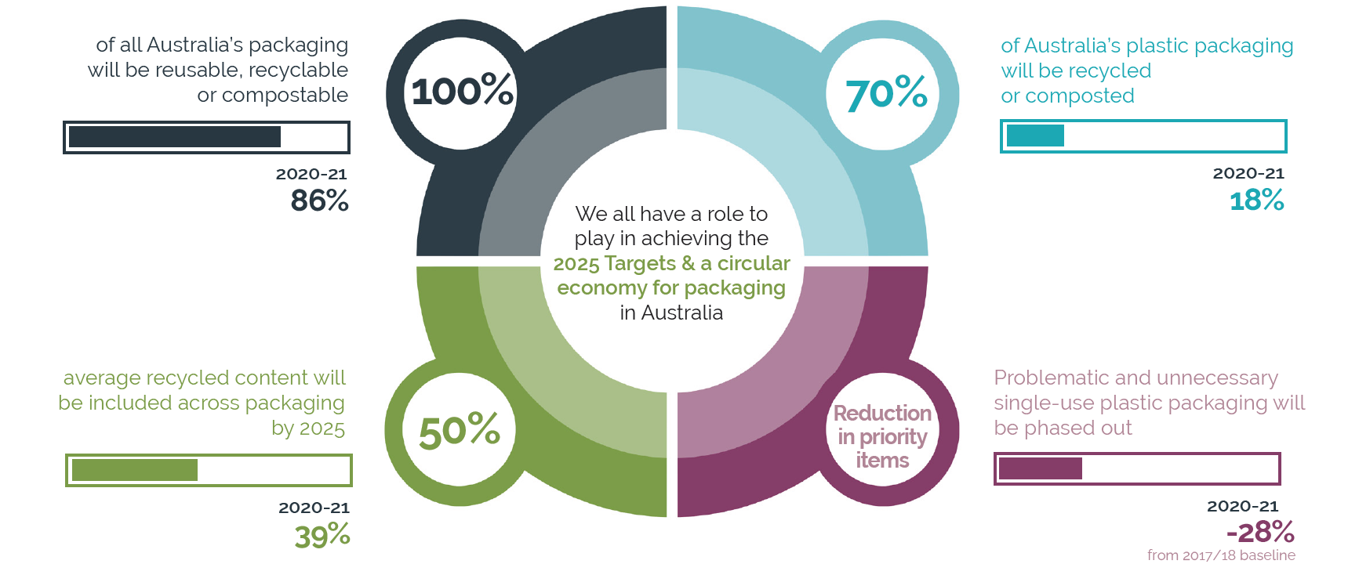
2025 National Packaging Targets
Notes:
The SPGs are there to help organisations meet the National Packaging Targets. Last year, we released a report on how we are tracking on those targets.
Target 1: As you can see, we are making reasonable progress towards recyclability, hitting 86%. We are now commissioning a deep analysis of the remaining 14%. This tail comprises a great many little products and components, each comprising less than 1% of this segment. APCO is exploring which of these can be solved, what is not actually packaging and where the line of diminishing returns suggests we should focus on the other higher impact projects that are better able to shift the dial on recovery.
We are doing this because the other targets still need serious attention to bend the trend line
Target 2: Recycled content is 11% below target, but the technical potential of some materials is much higher than 50%. To lift this number we need to get polymers with high potential, delivering at high potential. And we need to work on specs and design to get other polymers up to the quality and consistency that is needed to create a demand pull through.
Our committees will work across R&D, government and industry to remove barriers and stimulate end-demand for recycled polymers. This forms a key plank of our strategy going forward
Target 4: SUPPS is coming down. The 2021 data shows a 28% reduction. That’s a minor increase on the previous year's data. But this is 2020-2021 data and there is likely to be some covid impacts in this year. The data is not yet showing the full impact of bans that have come in subsequently, so a good target to watch in the next couple of years as those bans take effect.
Target 3: Saving this one for last because clearly this will be a major focus for APCO and industry in the year ahead. Plastics packaging being recycled or composted, languishing at 18% on a 70% target and definitely in need of some love and attention. The Rigid and Flexibles materials stewardship committees are likely to be our busiest in the year ahead.

Slide 9
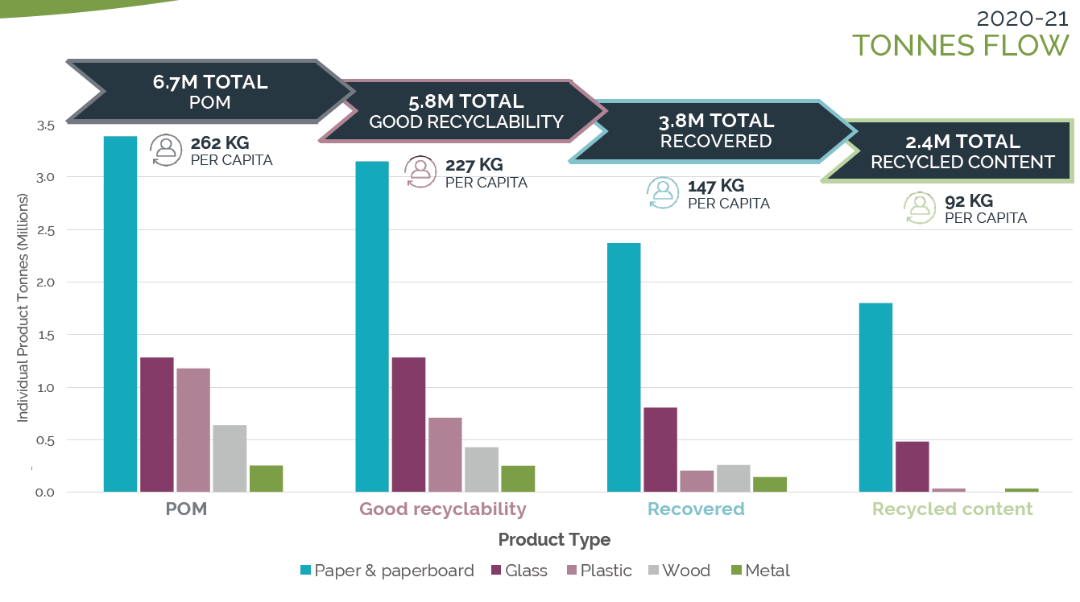
Notes:
This chart from our summary fact sheet further illustrates that we have a system problem, with 2/3 of recyclable materials not making it through the value chain to be remade into new goods.
That’s why we are refreshing and restructuring our committees to focus on the end-to-end value chain, and on delivering not just the avoidance of landfill, but working towards highest and best outcomes for key materials
This fresh perspective and increased ambition needs fresh minds with a passion to help us accelerate the change, not only to deliver against the 2025 targets but to set our sights on the ambition beyond – a circular economy for packaging.
To have impact everyone in the value chain needs to play their part and be confident that others are playing theirs.

Slide 10
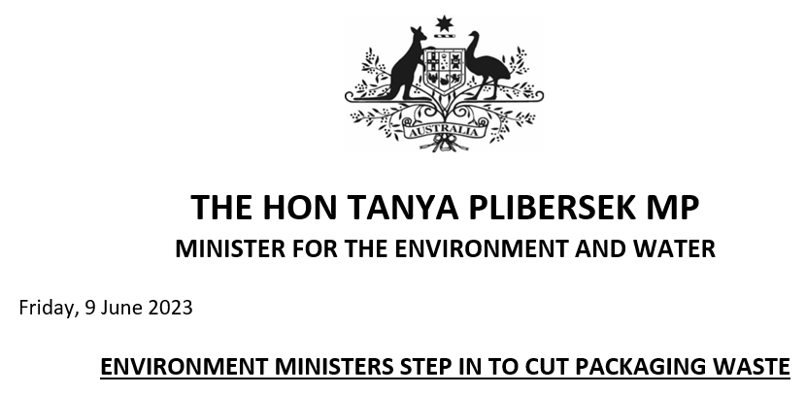
Environment Ministers Meeting, 9 June 2023
Packaging will soon be subject to strict new government rules aimed at cutting waste and boosting recycling.
Mandatory packaging design standards
Mandatory targets – including for recycled content
10
Notes:
We can be confident that we need to take these results and all following actions seriously.
Key takeaways from the recent EMM…
Ministers believe voluntary targets and voluntary design guidelines aren’t getting the traction needed and they expect the companies responsible for producing packaging are going to take responsibility for their waste.
Ministers have committed to develop a national roadmap to improve harmonisation of kerbside collection.
From my perspective…I’m not surprised by the EMM communique – the key items it called out on packaging were also flagged in our recent review report on the National Packaging Targets included mandating design standards and targets.
There were two other things called out specifically by Ministers: Hazardous chemicals (such as PFAS) and the challenge of getting the right policy and industry settings on compostable packaging. Those are two of the things we’ve been working on with governments and industry (we’ve delivered a roadmap to phase out PFAS and we’re commencing the next phase of work on PFAS).
So we’re confident we’ll be able to meet Ministers expectations on those two things.

Slide 11
National Environmental Protection Measure reset
Observations and thoughts…
Ambitious reform is coming
Framework will include mandatory design rules and targets
Recycled content will become key
Governments are analysing options
Need for jurisdictions to be aligned
Reformed framework in place by 2025
Consultation is coming
Decisions by ministers over the next 12 months
11
Notes:
NEPM Reform:
Ministers have made it clear that NEPM reform is coming, and that it will be ambitious.
The EMM communique confirms that the new framework will include mandatory design rules, but we can be confident that there will be other regulatory interventions. I expect that those will include an end-market measure to drive uptake of recycled content, but we’ll have to wait and see what that will look like.
We know that governments have been very busy behind the scenes undertaking analysis of options for a reformed co-regulatory framework. It’s important they get all jurisdictions aligned.
Ministers have previously committed to having a reformed framework in place by 2025, so we anticipate that public consultation will start in the next 6 months to prepare for decisions by ministers over the next 6-12 months.

Slide 12
Preparing for a stronger co-regulatory model.
The Commonwealth and State and Territory Environment Ministers have committed to reforming the framework for packaging, with the reformed framework to be in place by 2025.
Between now and 2025, action is needed to accelerate progress towards the 2025 Targets.
Mandated Targets and Design Standards and system obligations to further drive the transition to a circular economy for packaging.
12
Notes:
We are preparing for a stronger coregulatory model by breaking or strategy into two horizons.
Horizon #1 Strategy
Aims to close the gap on National Packaging Targets while laying the foundations for a stronger co-regulated packaging system post 2025
A reset APCO focussed on closing the gap
Improving the way we engage the entire packaging system
Prepare for whole of system approach to (quality) data
Focus on design guidelines and making them regulation ready
Support for industry stewardship schemes
Focus on priority material and gaps for greatest return
Horizon #2 Conceptual vision post 2025
A strengthened co-regulated circular packaging system deliver circular economy outcomes
Mandated system targets
Alignment and involvement of the entire packaging system
Member obligations drive achievement of targets
Whole of system (quality) data
Aligned packaging design & collection systems

Slide 13
ARL
Australasian Recycling Label

Slide 14
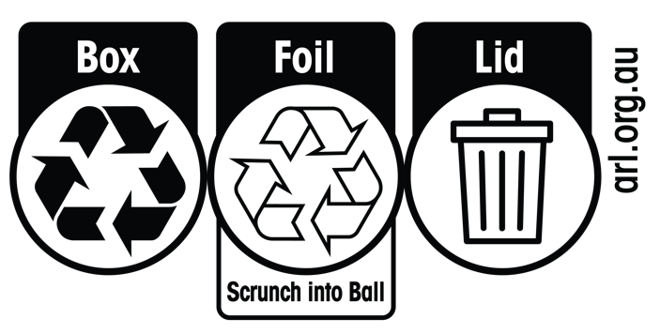
Australasian Recycling Label
Easy-to-understand instructions about how to correctly dispose of all parts of a product’s packaging
Evidence-based, national program created in partnership between APCO, Planet Ark and PREP Design
Used by over 900 APCO Members (mostly large organisations) across more than 200,000 SKUs
Used by packaging manufacturers to verify product recyclability claims
Providing a regionally consistent labelling approach for Australia and New Zealand
Supported by all Australian governments to make recycling easy.
75%
55%
are more likely to purchase a product when packaging is labelled with the ARL.
consumers want to see the ARL on all packaging components
14

Slide 15
How the ARL Works
Packaging Recyclability Evaluation
Better understanding of materials’ recyclability
Feedback loop between recycling and design
Standardised point of information for consumers
Clear identification of packaging components and respective recyclability
Evidence-based – Technical and kerbside recyclability information
15

Slide 16
‘Check Locally’ ARL
Recovery solutions are changing faster than packaging update cycles
Collections expected to return in 12-18 months
New "Check Locally" ARL logo for soft plastic packaging to be applied when artwork is updated or when creating new product lines
Replace REDcycle as soon as practical
16

Slide 17
‘Check Locally’ ARL
Updated icon reduces consumer confusion regarding use of transparent mobius loop for soft plastic packaging.
- Bin Audit
- Consumer testing
Logo does not replace the Conditionally Recyclable ARL. It is a new labelling option for:
1. Soft plastic packaging that meets thresholds.
2. Other packaging that is ‘less widely accepted’
Less widely accepted = between 60% and 80% of
the kerbside population has access to a council
service that collects the material.
e.g. aseptic cartons in Australia
17
Notes:
Reduced consumer confusion around CR ARL and soft plastics.
Based on data and observations from bin audit and consumer testing

Slide 18
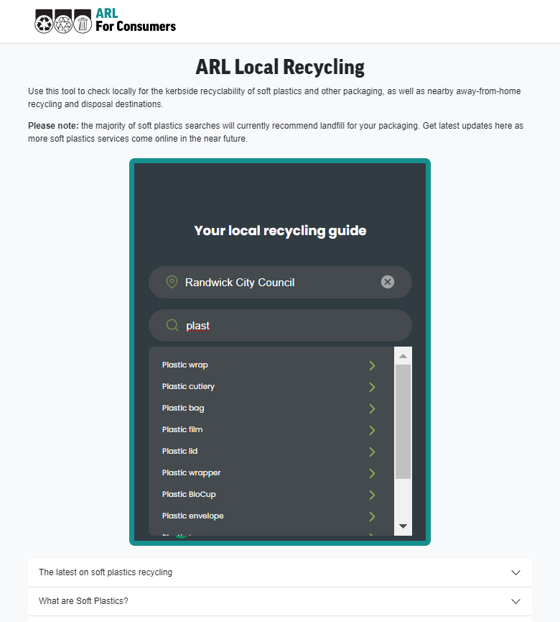
Updated ARL.org.au Website (Australia Only)
Stage 1 - Features
Consumers check locally for kerbside collections, plus nearby 'away-from-home' destinations.
Changes are designed to manage risk for brand owners with packaging already in market
300+ soft plastic search terms pre-loaded. Natural language search for an item.
PREP aligned but not yet live integrated (due diligence undertaken for alignment and governance).
18
Notes:
Localised services will be reflected as they become available and as “check locally “label enters the market
Whilst not fully data integrated yet, we have compared the two products to ensure alignment and advice is the same in 99% of cases
- Soft launching with our members today to identify any remaining points of divergence prior to public launch

Slide 19
Thresholds (Australia Only)
Key changes to note
Primary materials - polyolefin content has increased from a min 70% to 80% (green);
PET, PVDC, Paper and Aluminium (not including metallised layers) are not recyclable at any % (red);
Nylon, EVOH and PVOH decreased from 30% to 10% inclusion (yellow).
AlOx, SiOx and Acrylic are considered recyclable up to 10% (yellow).
PVC, PS and Bioplastics/compostable plastics remain unacceptable at any percentage (white).
19
Notes:
What has changed from previous thresholds

Slide 20
Food Packaging
What’s Next?

Slide 21
Food Packaging Watch Outs
Compostable Packaging
Access to compost solutions is limited for consumers. To facilitate improved access, better design is also needed.
Deliver on the PFAS Action Plan.
Ensuring compostable packaging is the best solution.
Soft Plastics
Recovery solutions are coming online, but a transition to leading practice design is required.
Reuse
How can we encourage systems for reuse?
21

Slide 22
Thank you
Sarah Sannen
Head of Operations
ssannen@apco.org.au
Notes:
Needs to contain space for speaker, job title, presentation title
New logo

