Slide 1
New product development in food technology
Patents and trade marks
Brittany Ashton and Sarah Dixon
24 July 2023
foodpro 2023

Slide 2

Acknowledgement of Country
We acknowledge the Traditional Custodians of country throughout Australia and their connections to land, sea and community.
We pay our respect to their Elders past and present and extend that respect to all Aboriginal and Torres Strait Islander peoples today.

Slide 3

About FB Rice
  Largest independent, privately owned specialist IP firm in Australia
  Established in 1949 - offices in Sydney, Melbourne, Brisbane, Perth and New Zealand
  Experts in navigating IP in the Asia Pacific region
  Full breadth of patent technical expertise with over 50 practicing patent attorneys in all areas of technologies, many with PhDs
  Strategic advice on prosecution and protection of trade mark portfolios both in Australia and globally, provided by registered trade mark attorneys and qualified practicing solicitors

Slide 4
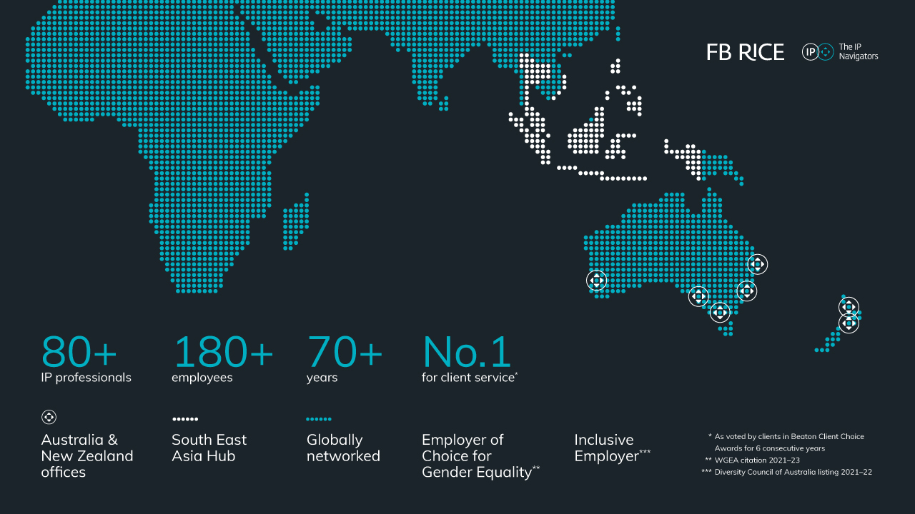

Slide 5




Our awards
  Best Specialist IP and Related Services Firm
  Best CX Firm: Specialist IP & Related Services
  Most Innovative Specialist IP & Related Services Firm
  Beaton Client Choice Awards 2023
  Tier 1 Patent and Trade Mark Prosecution
  Managing Intellectual Property (MIP) IP STARS 2022
  Gold recommendation: Patent Prosecution
  IAM Patent 1000 2023
  Gold recommendation: Trade Mark Prosecution and Strategy
  World Trademark Review 1000 2023

Slide 6

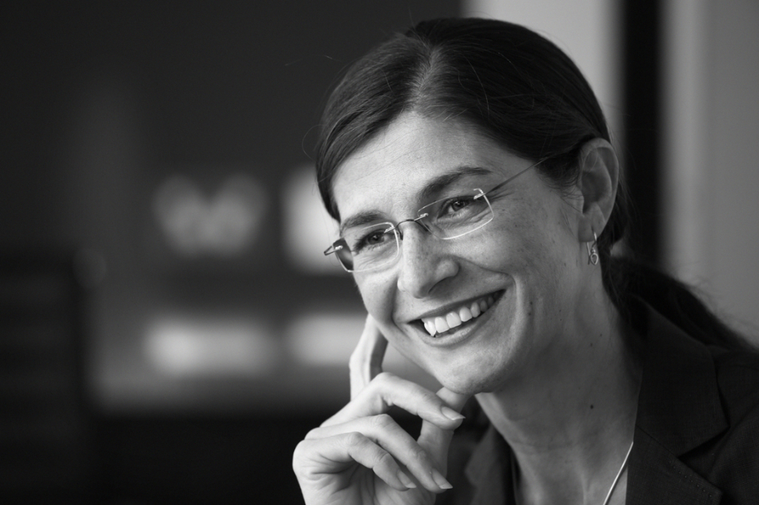




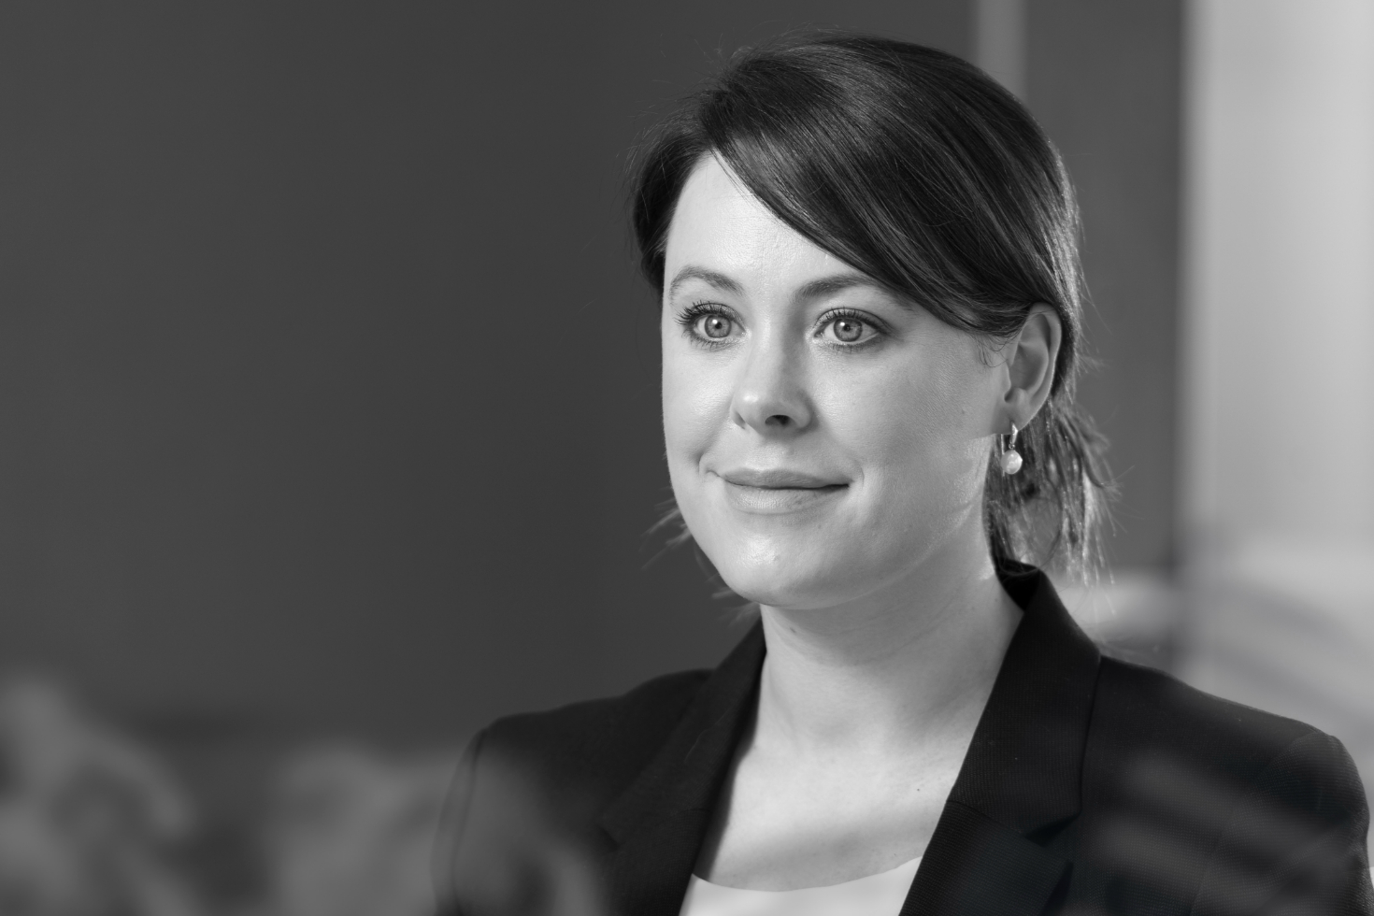


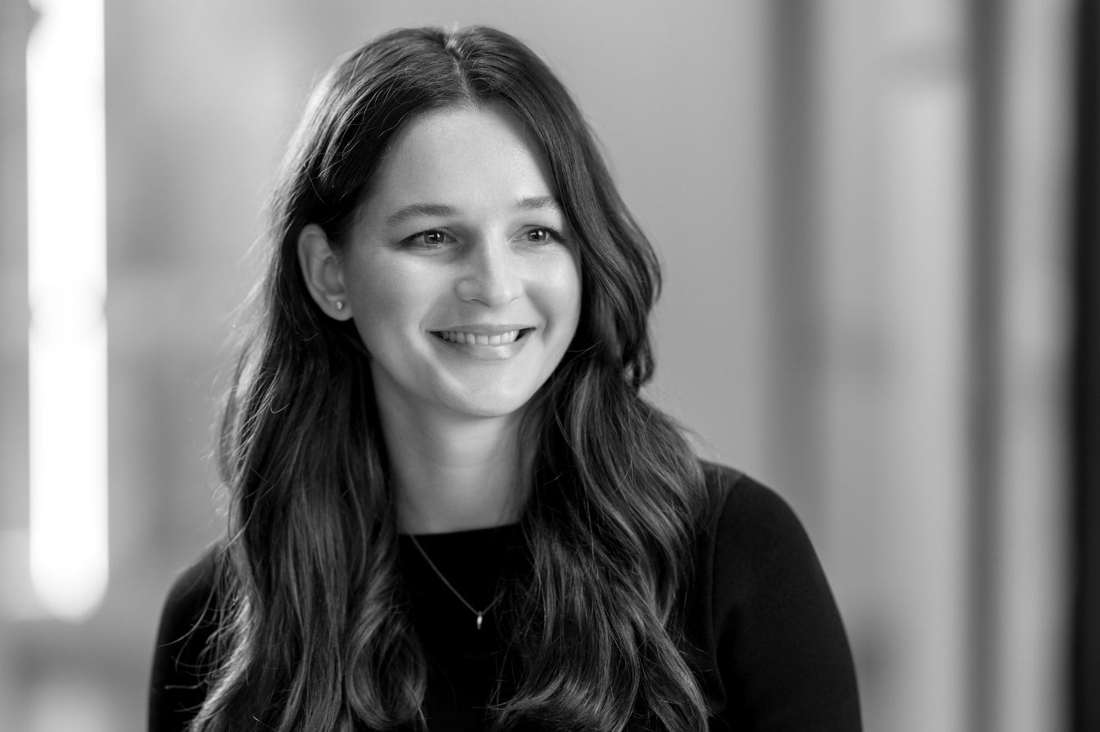
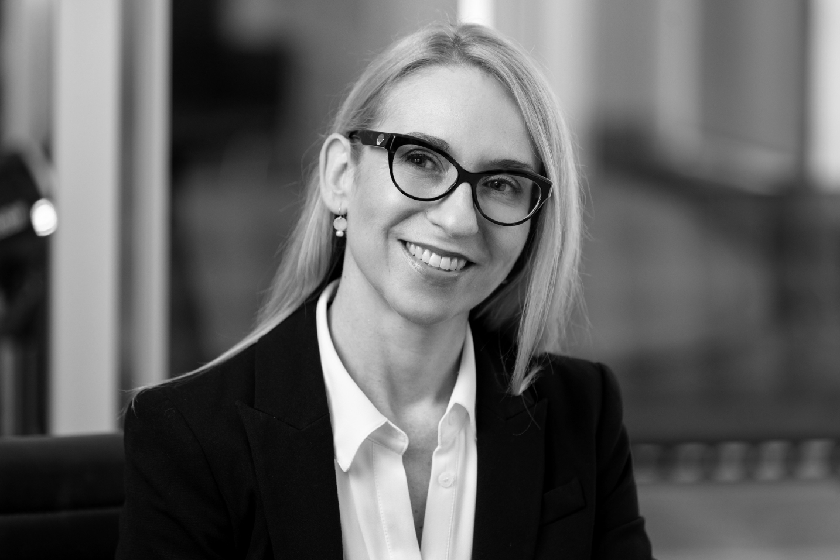
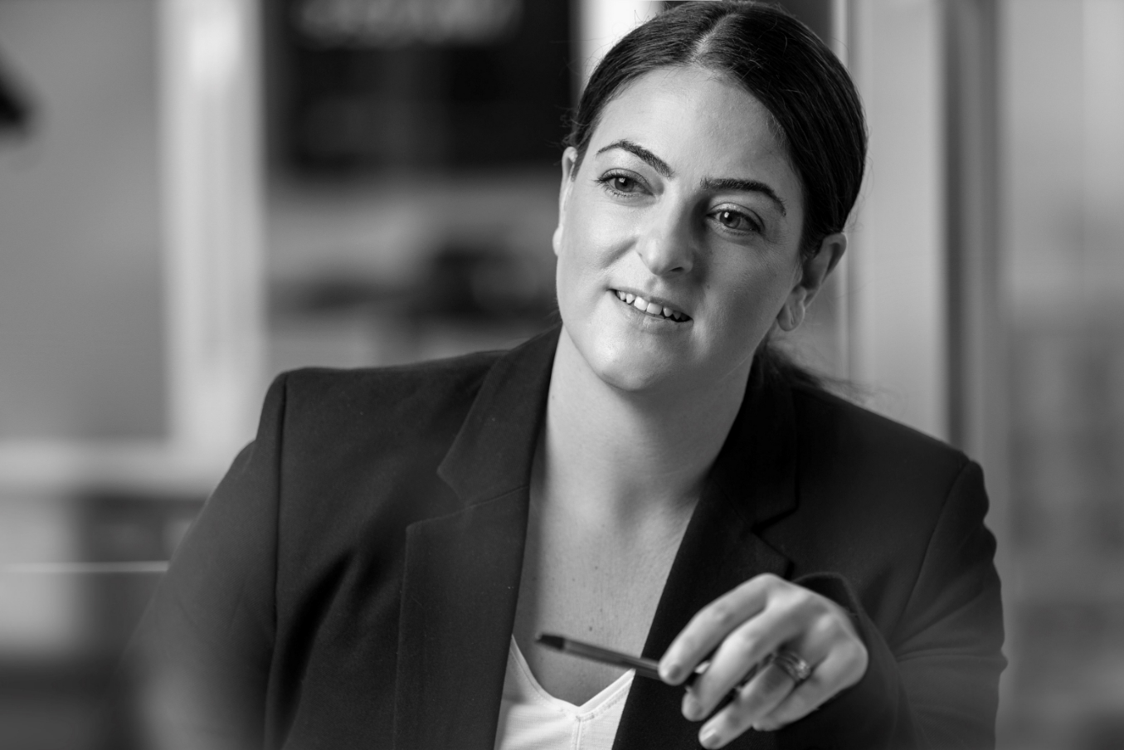



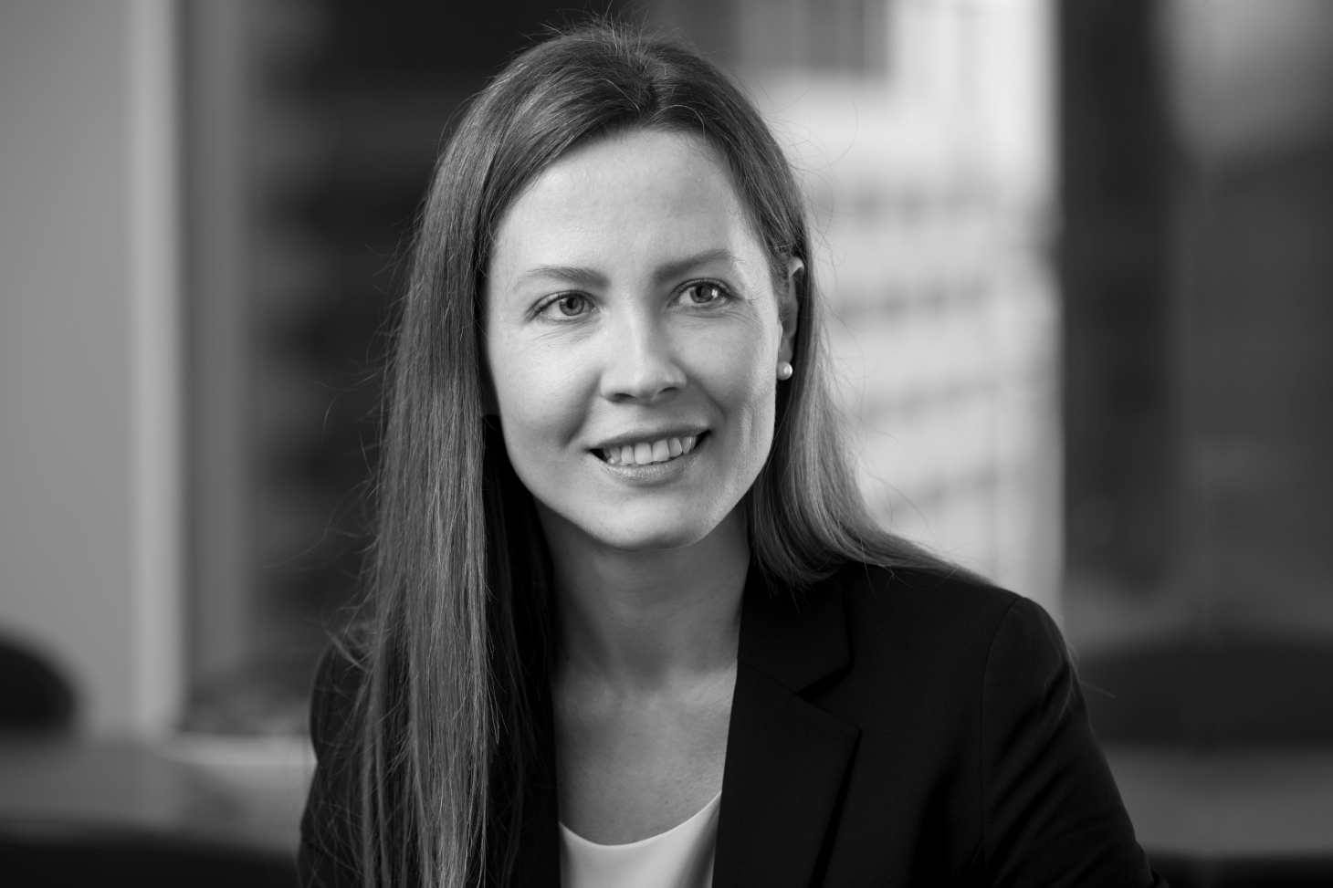


Our food and beverage experts
John Landells
  Partner
Jacqueline Warner
  Special Counsel
Marcus Caulfield
  Partner
Sarah Glasson
  Senior Associate
Sheila Barbero
  Senior Associate
Diana Bogunovic
  Senior Associate
Brittany Ashton
  Senior Associate
Declan McKeveney
  Partner
Michael Seifried
  Partner
Kate Baumann
  Associate
Lisa Neilson
  Senior Associate
Sarah Dixon
  Senior Associate
David Loch
  Partner
Ian Rourke
  Partner
Desma Grice
  Senior Associate
Maria Matveenko
  Associate
Lara Gun
  Senior Associate
Jeremy Dobbin
  Partner

Slide 7

What is IP, and why is it relevant?
Intellectual property can be considered:
  “creations of the mind”
  “products of human intelligence and creation”
  “intangible property that is the result of creativity”
Any new idea, discovery, invention, mark, scheme, concept or way of performing a task or function, that is the result of human intellectual activity.

Slide 8




Forms of IP protection
Trade mark
  Name, logo, fonts, slogan
Copyright
  Overall layout, shape
Patent
  Products – ingredients and foods (e.g. lactose free milk composition, food products thereof), packaging (e.g. opening configuration)
  Processes – preparation of ingredients, manufacture of products
  Uses – product area (e.g. beverage) or applications (e.g. health claims)
Design
  Shape, configuration, ornamentation
Notes:
Process claims can be used to protect ‘modified’ products, which can be broader than product claims per se

Slide 9
Patents

Slide 10

Patent fundamentals
  Legally enforceable right to exclude others from commercially exploiting your invention
    make, use, sell
  Standard patent term 20 years
  Exchange protection for public disclosure
  Patent claims define what is protected – “staking out” your territory
    Infringement: products or processes falling within a claim will infringe
    Patentability: ability of the claims to meet requirements for a patent

Slide 11
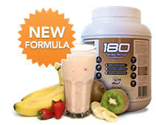
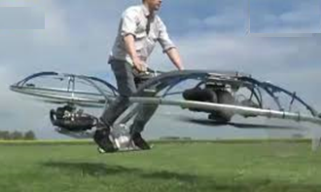


What is patentable?
  Think of an invention in terms of a solution to a problem
    New solution = patentable
    New solution + commercial value = SHOULD patent
Novel (new)
Inventive (not obvious)
Useful (applicable in industry)
Patentable subject matter

Slide 12

Food and beverage technology patents
  Readily able to meet patentability requirements
  Not available in many countries until late 1980s
  Foods, beverages, ingredients, processing aids
  Enzymes, pre-/pro-/post-biotics, bioactive extracts
  Examples include:
    a plant sourced binding agent for replacing egg albumin for vegan food products
    a plant extract for improving growth performance as feed supplement for fish stock
  Estimates indicate about 10% of all patent applications are now in the food technology area

Slide 13

Patents as a business commercialisation tool
  What value does a patent offer?
  defensive publications and freedom to operate
  deterrents
  market exclusivity
  collaboration tools – encourages cross-licensing in research
  negotiation and exchange
  branding and marketing
  patent licensing
  financially support further product development

Slide 14
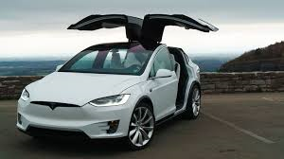
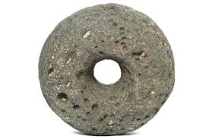
Freedom to Operate (FTO)
  Having a granted patent means others need permission from you to use your invention
    but it does not mean you have FTO to launch a product embodying your invention
  Is there a licensing deal?
You invent and patent the electric car…
…but Caveman Enterprises Pty Ltd already have a patent on the wheel

Slide 15




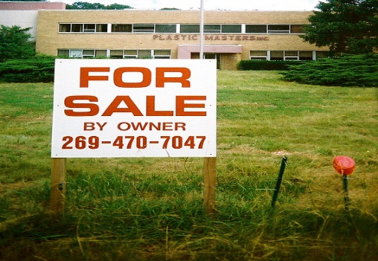
Freedom to Operate considerations
  Carrying out a full FTO search can be expensive ($10-15k)
  What aspects of your product will you search?
  And where (AU, NZ, US, EP, CN)? Where are you manufacturing? Selling?
  Consider appropriate timing – is this the commercial form? Staged approach?
  What to do if you identify an FTO issue?
Design around
Seek a license
Attack the patent
Change country
Abandon project

Slide 16
Trade marks

Slide 17



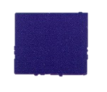
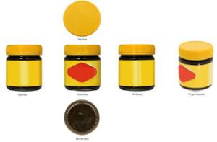
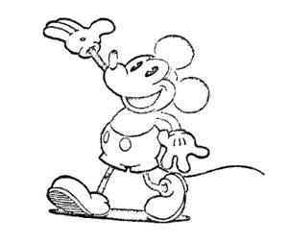
Trade marks – what are they?
  A “badge of origin”
  Trade marks can be any letter, word, name, signature, numeral, device, brand, heading, label, ticket, aspect of packaging (trade dress), shape, colour, sound or scent, or any combination
Number | Mark | Goods/Services | Owner
1120614 Registered |  | Block chocolate; boxed chocolate | Cadbury UK Limited
1365687 Registered |  | Yeast extract spreads containing dairy products; etc. | Bega Cheese Limited
65836 Registered |  | Motion picture films prepared for exhibition | Disney Enterprises, Inc.

Slide 18

Trade marks - what do they protect?
  Registered and unregistered marks
  “Goodwill” - rights accrued through use (common law)
  Registration affords protection under the Trade Marks Act 1995 (Cth)
  Trade mark must be able to distinguish goods/services from those of other traders
  Trade mark cannot be “substantially identical” with or “deceptively similar to” another mark
  A trade mark registration designates goods and/or services from 45 international classes

Slide 19

Trade marks registration
  Why register?
  Ease of enforcement
  Assignment of trade mark rights much easier
  Book value of registered rights (commercialisation/funding tax benefit)
  What if I don’t register?
  Time, costs and inconvenience with enforcement
  More difficult to describe and assign
  Difficulty with valuing and tax treatment of “goodwill”

Slide 20

Food for thought…
  Who are your customers (all of them) and how is the mark being used?
  Does your mark include a geographical indication?
  Are you exporting and do you require protection overseas?
  Are you at risk of being infringed online?

Slide 21
Brittany Ashton
Patent Attorney
bashton@fbrice.com.au
Sarah Dixon
Trade Marks Attorney
sdixon@fbrice.com.au
fbrice.com.au

Slide 22
Disclaimer
The content of these materials is general in nature, and must not be relied on in lieu of advice from a qualified professional in respect of your particular circumstances. To the maximum extent permitted by law, FB Rice does not make, and excludes, any representation or warranty, express or implied, as to the accuracy, reliability, currency or completeness of any information in these materials and FB Rice (collectively, with its partners, officers, directors, employees, agents and advisers) expressly disclaims any and all liability for any loss or damage, howsoever caused, relating to these materials or from acting in reliance on the information within them. For the avoidance of doubt, the delivery of these materials, or the provision to you of any part of its content, does not create an attorney-client relationship between you and FB Rice.

