Slide 1
Leveraging Bio-based Food Ingredient Solutions to Reduce Food Waste
APAC

Slide 2
Corbion: our purpose
We champion preservation in all its forms:
Preserving food and food production
health
planet

Slide 3
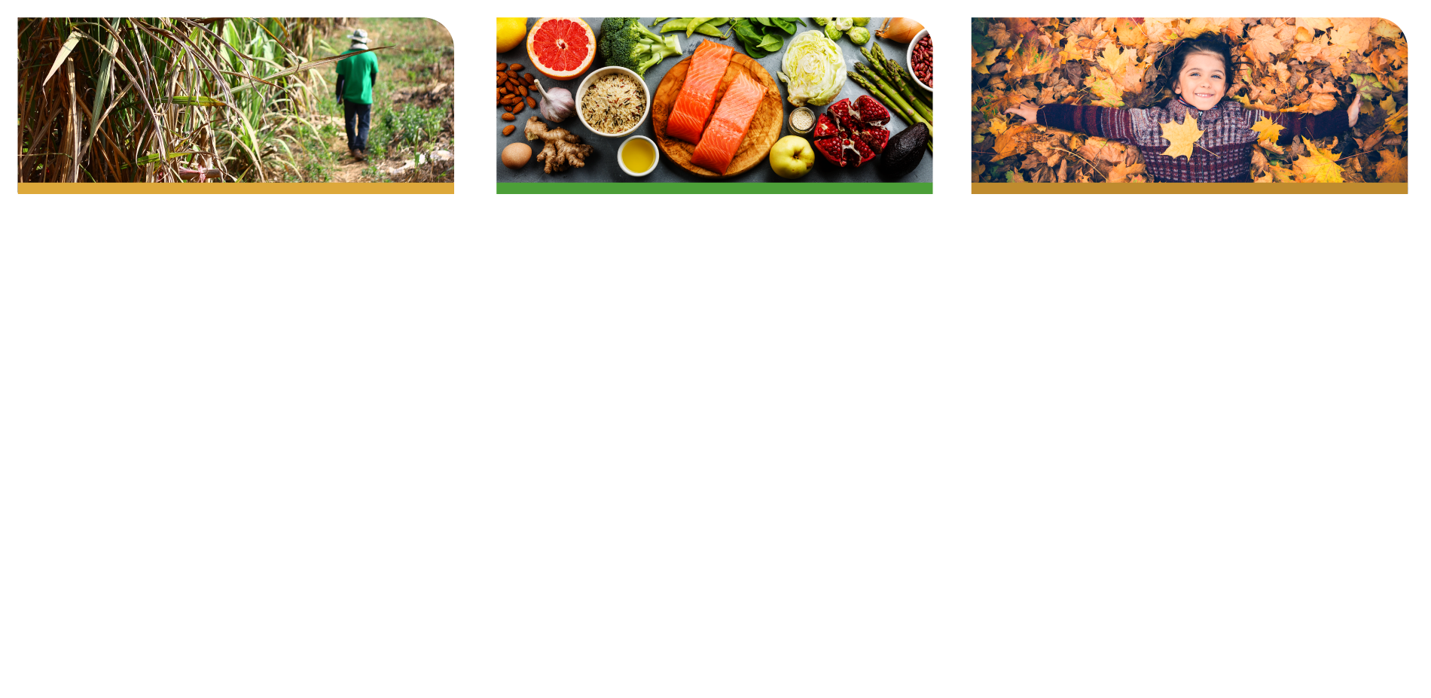
Putting preservation into action How we contribute to the SDGs
Preserving food & food production
Preserving health
Preserving the climate
Food safety, shelf-life, texture, and nutritional benefits with food solutions
Ecosystems by offering alternative aquaculture feed to prevent overfishing
Natural resources by partnering with our suppliers to promote sustainable agriculture
The safety of our people
Health and well-being with biomedical solutions
Hygiene and health with biochemical solutions
Heart and brain health with algae solutions
Natural resources with biobased and biodegradable alternatives with lactic acid specialties
The oceans by enabling responsible aquaculture with algae solutions
Human rights and the environment through responsible sourcing
The climate by working toward carbon neutral operations

Slide 4
Leveraging Bio-based Food Ingredient Solutions to Reduce Food Waste
*FLW
Consumer
Demands
*FLW
Consumer
Demands
*FLW (Food loss & waste)
Source: https://gifer.com/en/LHDQ
Notes:
Dilemma/tension

Slide 5
Food Loss and Waste (FLW) - Macro: A problem with multifaceted implications
33% Unconsumed Food (Lost & Wasted)
Produced Food
Consumed Food
Resources: Water, Energy, Fertilizers
Environmental
25% water & fertilizer used in agriculture
10% (up to) of global GHG emissions
Social
25% of which can feed 870mil. pax.
Economic
>$1 trillion every year
“And if current trends persist, food loss and waste will double by 2050” (WRI 2023)
Sources: FAO (2016) Make #NotWasting a way of life – How much food is lost or wasted?, WRI (2023) The Global Benefits of Reducing Food Loss and Waste, and How to Do It, By Liz Goodwin, https://www.flaticon.com
Notes:
WRI:
WRI is a global research organization that works with governments, businesses, multilateral institutions and civil society groups to develop practical solutions that improve people’s lives and ensure nature can thrive. We organize our work around seven global challenges: Food, Forests, Water, Energy, Climate, the Ocean and Cities. We analyze these issues through the lenses of our four Centers of Excellence: Business, Economics, Finance and Equity.
870mil tons FLW annually
1 trillon $ – US 230-332mil, AU36.6-25.7mil
Food loss refers to loss at or near the farm and in the supply chain, for example, during harvesting, storage or transport. Food waste occurs at the retail level, in hospitality and in households.
Food loss and waste are caused by a wide range of issues, from technological challenges to consumer behaviors.

Slide 6
Food Loss and Waste (FLW) - Micro: Zooming into the food production value chain
Most food waste occurs at the consumer level
Graph adapted from: Lipinski, B. et al. 2013. “Reducing Food Loss and Waste.” Working Paper, Installment 2 of Creating a Sustainable Food Future. Washington, DC: World Resources Institute.org.
Notes:
Share of Total Food Loss and Waste by Stage in the Value Chain, developed countries, 2009 (100% = 0.81 quadrillion kcal)
Causes within the food production value chain
Of course, causes are not exhaustive, i.e. political, covid disruptions, weather issues etc. etc.
Developed countries: North America and Oceania, Industrialized Asia, Europe

Slide 7
Food Loss and Waste (FLW) - Zooming in on Australia
“The Australian economy loses $36.6b per year due to food waste” – of which, ~50% attributed to households
“Australian households spend between $2,000–$2,500 per year on food that is wasted”
2.5mil. tonnes of food waste generated in Australia
Source: Queensland Government (2022) Food waste facts, https://www.flaticon.com
Notes:
https://www.rabobank.com.au/insights/2021/11/22/02/50/2021-financial-health-barometer-food-farming-infographic/
https://www.qld.gov.au/environment/management/waste/recovery/reduction/reduce-food-waste/facts#:~:text=The%20Australian%20economy%20loses%20%2436.6,on%20food%20that%20is%20wasted.

Slide 8
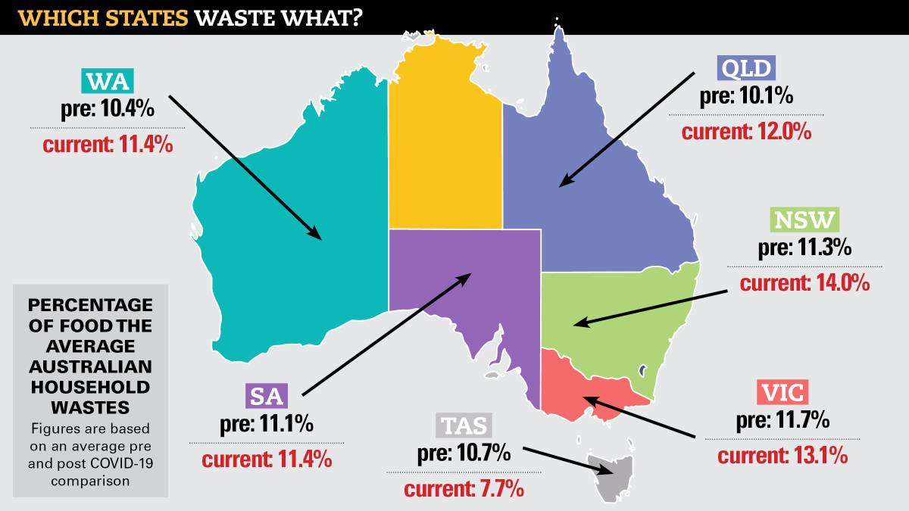
Food Loss and Waste (FLW) - Zooming in on Australia
Except for TAS, all other states shows an increase in household food wastes post covid.
Source: The Canberra Times, By Andrew Marshall (2021) Fresh food kits, takeaways, cooking experiments push waste bill to $10.3b, https://www.flaticon.com
Notes:
Possible causes: More home cooking, food delivery, experimentation, stocking up

Slide 9
Prevailing Consumer Trends - are potential drivers that can exacerbate the FLW problem at manufacturers and retailers
Convenience
Personalization/Variety
Naturalism
Higher POS/volatility = higher inventory fluctuations
Higher (niche/new) SKU launches =
potential longer turnaround
Removal of preservatives/unsustainable packaging =
potential shorter shelf life
= Potentially higher waste
Source: https://www.flaticon.com
Notes:
A sign for increasing demand for convenience:

Slide 10
How to reconcile FLW mitigation & meeting consumer demands? - UK study: 1 day extension to available life can make a difference
*Household level:
1 day more = reduction of ~5% of avoidable food waste = ~£158mil
More money to trade up at the store
Better shelf availability to consumer
**Retail level:
1 day more = reduction of ~20% of expired waste = ~£100mil
*UK study based on 5 product types, **UK study based on 9 product types
Source: WRAP (2015) Reducing food waste by extending product life, https://www.flaticon.com
Notes:
https://refreshcoe.org/wp-content/uploads/2017/06/Product-Life-Report_Mar2015.pdf
https://wrap.org.uk/sites/default/files/2020-12/Household-Food-and-Drink-Waste-in-the-United-Kingdom-2012.pdf
WRAP is a climate action NGO working around the globe to tackle the causes of the climate crisis and give the planet a sustainable future. We were established in the UK in 2000; we now work in 40+ countries.

Slide 11
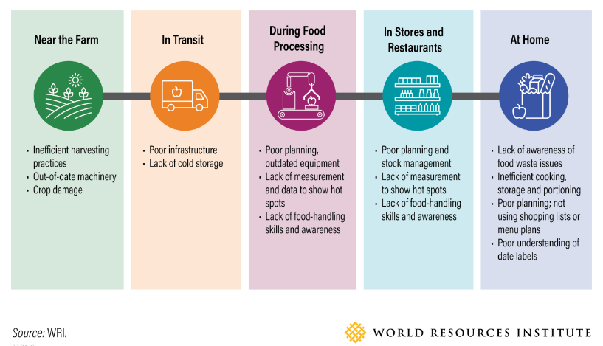
How to reconcile FLW mitigation & meeting consumer demands? - no silver bullet solution to this multifaceted challenge
Source: WRI (2023) The Global Benefits of Reducing Food Loss and Waste, and How to Do It, By Liz Goodwin, WRAP (2015) Reducing food waste by extending product life, https://www.flaticon.com
Notes:
WRI:
A global research nonprofit working on six critical goals that the world must achieve this decade in order to secure a sustainable future: goals are of the 6 topics of climate, energy, food, forests, water, cities and transports

Slide 12
Partnering with Corbion to increase available life of foods
SOLUTIONS PORTFOLIO
REGULATORY
Innovative and evolving portfolio of shelf life extension & food safety solutions rooted in our technical fermentation expertise.
In-region Regulatory team to support enquiries and registration as needed.
TECHNICAL SUPPORT
INSIGHTS
Expert partners in development and implementation to ensure a high probability of success and
Highly skilled team of dedicated analysts providing market and category insights to help you navigate the changing consumer landscape.

Slide 13
Partnering with Corbion to increase available life of foods
PuraQ® Arome
Predictive modelling tools
Solutions Portfolio
Verdad®
Origins®
Notes:
Mention CLCM

Slide 14
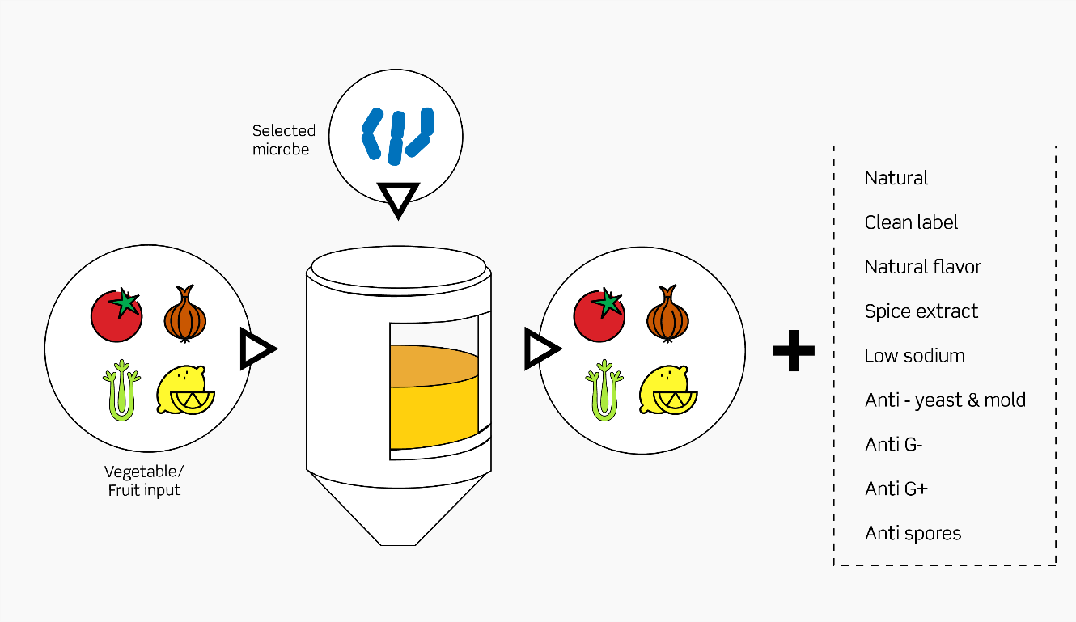
Verdad® natural ferments based on bio-based raw materials
Partnering with Corbion to increase available life of foods
Bio-based raw material like sugar from sugar cane
Fermentation process
Classified as food ingredients in AU
Carbon dating tests results available on request
Commercialized
Food-approved microbes
Plant-based input

Slide 15
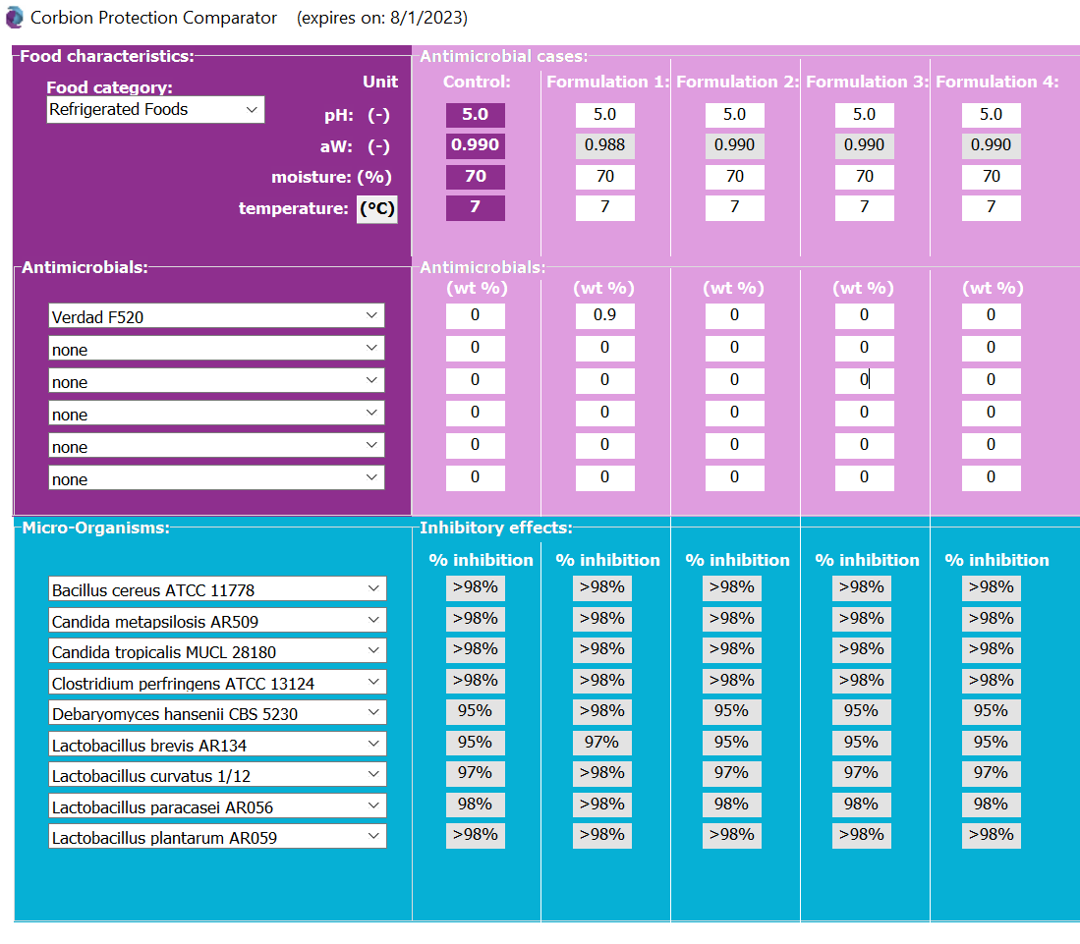
Proprietary modelling tools that contribute to your efforts to mitigate food spoilage and waste
Partnering with Corbion to increase available life of foods
Reduces the number of challenge studies needed to identify right solution & speed up time to market
Notes:
Model development based on bioscreening studies (broth data), actual Corbion challenge tests, relevant variables etc.

Slide 16
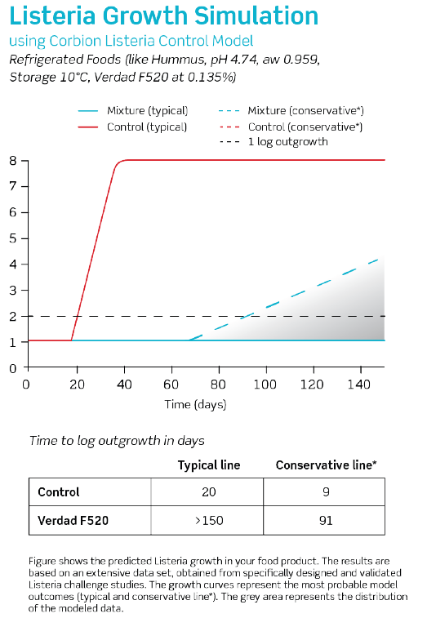
Proprietary modelling tools that contribute to your efforts to mitigate food spoilage and waste
Partnering with Corbion to increase available life of foods
Reduces the number of challenge studies needed to identify right solution & speed up time to market

Slide 17
Partnering with Corbion to increase available life of foods
PuraQ® Arome
Predictive modelling tools
Solutions Portfolio
Verdad®
Origins®
Analytical Specialists
Application Specialists
Food Scientists
3 Bio-safety level II labs globally
Technical Support
Microbiologists
Notes:
Mention CLCM

Slide 18
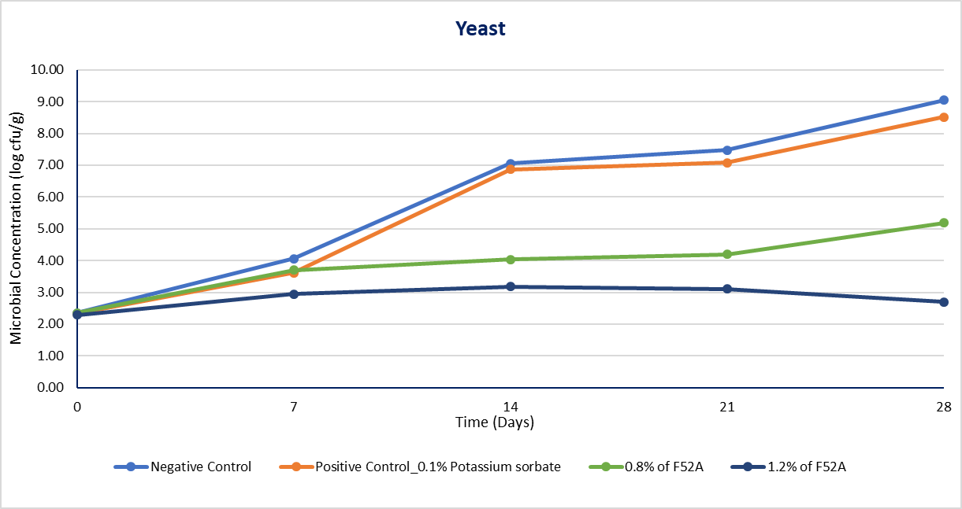
Partnering with Corbion to increase available life of foods
Verdad® Challenge Test in Hummus
Inoculated: Saccharomyces cerevisiae; Candida parapsilosis
Storage: 10ºC for 28 days, Aerobic packaging
Takeaway: - Verdad® Powder F52A showed inhibition against yeast, especially at higher dosage (1.2%). - Inhibit yeast growth up to 28 days under accelerated conditions
Sample | Initial pH | Water activity | Moisture content
Negative control | 4.70 | 0.9648 | 62.10%
Potassium sorbate 0.1% | 4.78 | 0.9658 | 61.95%
0.8% F52A | 4.74 | 0.9557 | 61.82%
1.2% F52A | 4.84 | 0.9505 | 62.04%
Notes:
Explaining the results:
Potassium sorbate likely insufficient for Yeast, esp. at higher temperatures where yeast will grow very fast
Also, sorbate are more effective in inhibiting LAB than Yeast
However, there may be regulatory hurdles to use more than 1000ppm potassium sorbate
Pour plate

Slide 19
Partnering with Corbion to increase available life of foods
Verdad® Challenge Test in Hummus
Inoculated: Lactobacillus Plantarum; Lactobacillus Brevis
Storage: 10ºC for 28 days, Aerobic packaging
Takeaway: - Verdad® Powder F52A demonstrated good antimicrobial efficacy against LAB - Inhibit LAB growth up to 28 days under accelerated conditions
Time (Days)
Sample | Initial pH | Water activity | Moisture content
Negative control | 4.70 | 0.9648 | 62.10%
Potassium sorbate 0.1% | 4.78 | 0.9658 | 61.95%
0.8% F52A | 4.74 | 0.9557 | 61.82%
1.2% F52A | 4.84 | 0.9505 | 62.04%
Notes:
Explaining the results
Other contributory hurdles for LAB inhibition is temperature and aw (<0.92)
Pour plate

Slide 20
Closing
Albeit complex, mitigating FLW & meeting consumer demands can be addressed synergistically.
All it takes is for us to know & build our area of expertise and act together today.
Source: https://www.flaticon.com

Slide 21
Looking forward to speak with you @Booth E14!
Eugene Seah
APAC Business Development Manager

Slide 22
Disclaimer
No representation or warranty is made as to the truth or accuracy of any data, information or opinions contained herein or as to their suitability for any purpose, condition or application. None of the data, information or opinions herein may be relied upon for any purpose or reason. Corbion disclaims any liability, damages, losses or other consequences suffered or incurred in connection with the use of the data, information or opinions contained herein. In addition, nothing contained herein shall be construed as a recommendation to use any products in conflict with existing patents covering any material or its use.

Slide 23
Notes:
'Best-before' dates give you an idea of how long foods will last before they lose quality. Most products will last beyond their 'best-before' date if they are stored properly. Foods marked with a 'use-by' date must be consumed before or on that date.

