Slide 1
The Sustainability Motor for Decarbonation Promises
Presenter:
Martin Orzinski
Global Executive Director, Supply Chain
July 2023

Slide 2
ESG
Environmental - Social - Governance
Graduating from sustainability and CSR to ESG
SUSTAINABILITY
CSR
ESG

Slide 3
Eco-wakening
INCREASED PRESSURE & REGULATIONS
GROWING GLOBAL PRESSURES
A REASON TO EXIST BEYOND MAKING MONEY
NET ZERO PROMISE COMPANIES PLEDGE TO ACHIEVE SUSTAINABILITY TARGETS
16%
190%
100% RECYCLABLE BY 2025
INCREASING THE USE RECYCLED MATERIALS
Concern of nature
65%
searches India
53%
twitter mentions
searches Indonesia

Slide 4
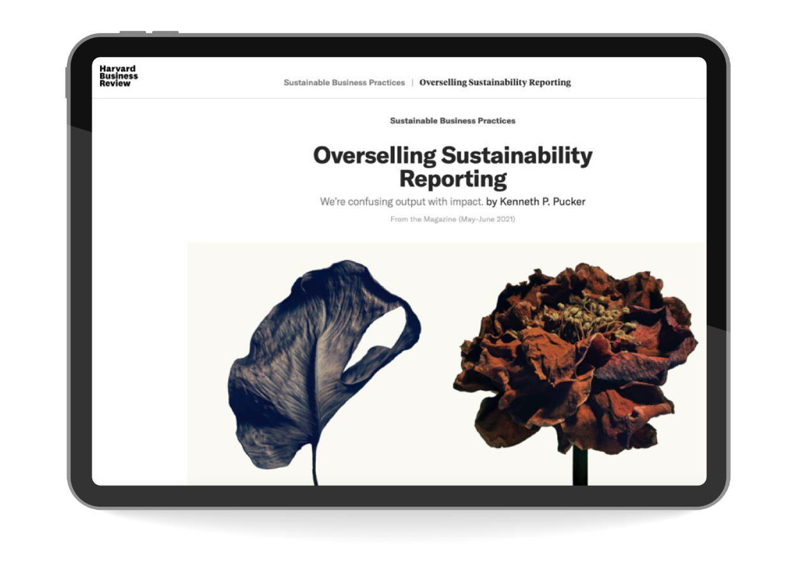
Recognised Challenges
To achieve these goals
NO ROADMAP
GLOBAL SUPPLY CHAOS
LACK OF PROBLEM-SOLVING SKILLS USING DIGITAL TOOLS

Slide 5
Roadmap
To deliver Decarbonation promises
Milestone 4
Roadmap: communication, training, stakeholder alignment, organisational readiness
Milestone 5
Governance: score card, decision making policy, RACI
Milestone 3
Gap analysis heatmap, Capability match, Capex requirement, quick wins
Milestone 1
As-is situation: packaging database, capability profile, stakeholder survey, quick wins
Milestone 2
Prioritised initiative hopper, pocket of excellence, global benchmark, quick wins
Comprehensive Diagnostic
Gap Analysis & Benchmark
Roadmap

Slide 6
Case Study - Coca-Cola Bottlers Japan Inc
End-to-end packaging review & development
CLIENT CHALLENGES
PROJECT SUCCESS
C
A
I
S
T
S
S
E
A & B-SKUs were not best-in-class design/ weights
Data availability restrictions
O
S
3-year roadmap with 17 significant tangible initiatives (>50 initiative hopper)
Cost saving opportunity of 8.5% identified
N
S
•
•
•
•
•
•
G
M
A
E
I
N
D
T
High supplier reliance and low inhouse packaging expertise
Unclear roles and responsibilities across the organisation
Consultants integrated successfully with the team
Improved packaging development process
with cross functional alignment step
The recruitment of a new packaging expert
Training & ongoing mentoring (global round table)
ENGAGEMENT
N
O
P
I
R
T
I
A
O
N
R
I
I
M
T
R
I
E
S
T
E
D
E

Slide 7
Diagnostic Phase – Common Findings
MASTER DATA DILEMMA - LACK OF DATA QUALITY AND AVAILABILITY
SILO THINKING – UNKNOWN POCKETS OF EXCELLENCE
CAPABILITIES NOT MATCHING ORGANISATION READINESS
SCORECARD NOT BALANCED – DECISION MAKING IS NOT SUPPORTING ESG

Slide 8
Governance and Ways of Working
PEOPLE, PLANET, PROFIT (3BL)
AMBASSADORS
SOCIAL RETURN ON INVESTMENT (SROI)
ADVANCED REPORTING
PROCESS EXCELLENCE
SHARED GOVERNANCE
DECISION MAKER (BOARD)
MEASURE TO IMPROVE
CO-AUTHORS
BUSINESS AS USUAL (BAU)
SUSTAINABILITY PLEDGE (C0₂e)

Slide 9
TMX Digital ESG Tools
TMX Simulation creates a digital version of the end-to-end supply chain. This allows every part of the physical system to be modelled and measured from vehicles and people to manufacturing.​ If you can't measure something, you can't manage it.
​
Combining simulation with the immersive TMX Metaverse, operations can pressure test the future state by experiencing practical solutions before implementation. ​
​
This promotes a “try before you buy” and a more efficient manufacturing operation, thus contribute towards sustainability objectives.​

Slide 10
So what?
1. Data Management
2. Strategy Execution
3. Form Partnerships
Data story telling is an art and science
New focus requires new skills & decision making
Leverage your organisation to pursue partnerships

Slide 11
Thank you.
www.tmx.global
COPYRIGHT: TMX all rights reserved. No part of this work may be reproduced or copied in any form or by any means (graphic, electronic or mechanical, including photocopying, recording, recording taping, or information retrieval systems) without the written permission of TMX.

